Slide 1
Password storage & Friends

Slide 2
COURSE SCHEDULE IS SHARP!
Tuesday → We start at 8:45 *SHARP*
Wednesday → We start at 10:30 *SHARP*
Thursday → We start at 9:30 *SHARP*

Slide 3
Password-based authentication
Still very common
Pros:
Cheap: easy to implement, can be easily distributed and stored
Security level is reasonable if the password workflow is properly implemented
Reference Material: Stallings-Brown Computer Security, Chap. 3, International Edition

Slide 4
Password-based authentication - II
Cons:
Proper password workflow implementations are rare (if they exist at all)
There are security problem at each step of the password workflow
Especially, the human factor is here crucial
"Humans are incapable of securely storing high-quality cryptographic keys, and they have unacceptable speed and accuracy when performing cryptographic operations. They are also large, expensive to maintain, difficult to manage, and they pollute the environment. It is astonishing that these devices continue to be manufactured and deployed. But they are sufficiently pervasive that we must design our protocols around their limitations. " -- Kaufman, Perlman, and Speciner quoted in Anderson's "Security Engineering"

Slide 5
Password workflow
Actors:
A user with credentials (UID + Pass)
Sometimes users are services themselves
A service (Web server, OS, etc.)
The user Host, the server host, the transmission medium
Workflow
User side storage
Credential input
Transmission
Validation
Server side storage

Slide 6
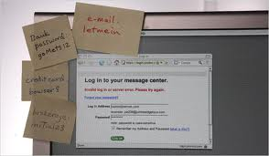
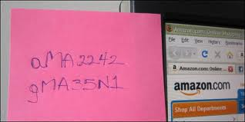
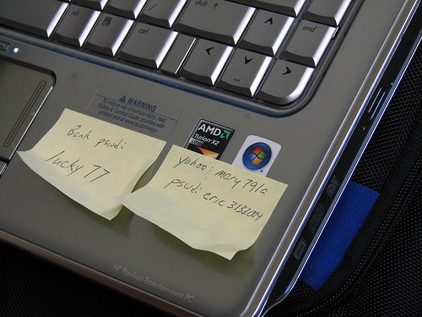
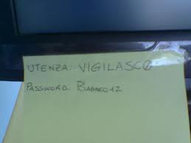
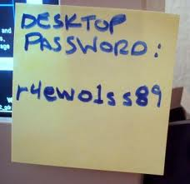
User SIDE storage
Mental storage
Paper storage
Digital storage

Slide 7
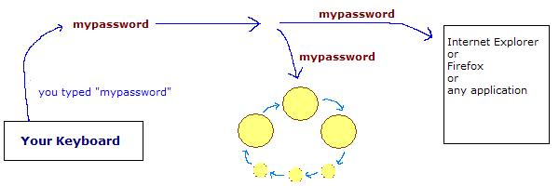
input
Keyloggers: hardware & software
keylogger beaters can mitigate the problem
http://www.keylogger.org/
Multiple way authentication can reduce the issue

Slide 8
Transmission
One should avoid proving knowledge of the password by transmitting the password!
Challenge based: HTTP digest, CHAP, MS-CHAPv2
--- See separate lectures ---

Slide 9
Password choice
Short or long?
Long, but recall that a keylogger do not care about your password length!!
Common or uncommon?
Multiple passwords or just one?
Should a password be changed often?
Should the server provider enforce a password format and a password expiry window?
Is the ‘secret question’ a good password recovery mean?

Slide 10
Password Storage
It is good practice not to store user passwords at ALL: better to use an hash of the password instead.
W.r.t. encryption with a secret server key, hashing guarantees that passwords can be verified by generating their hash, but it is not easy to convert back an hash value to its generating password
Brute forcing can be mitigated by iterating hashing multiple times
Note that users with same password will noticeably have the same hash in the password file
LOGIN DONE USING DIRECTLY THE PASSWORD HASH AS A CREDENTIAL IS NOT GOOD PRACTICE
Windows password encryption: http://technet.microsoft.com/en-us/library/cc512606.aspx

Slide 11
Rainbow Table ATTACKS
Build a dictionary with all the password which can be built, say, with ASCII words of 15 characters.
Compute the password hash of each of the above words. Index this table by hash value
You have now a rainbow table ready to go and distributable!
With a rainbow table, a brute forcing over a stolen password hash file is easy:
Just take an hash value h and lookup in the rainbow table!
Rainbow table attacks should not be possible on modern password storage schemes!

Slide 12
Rainbow tables - countermeasure
Easy to discourage this type of attack
Generate a nonce per each user (called salt)
Compute HASH(pass + salt), store HASH + SALT
When validating take SALT from password table and compute HASH(pass’ + salt) (pass’ is the user input)
Even a 16 bit salt makes building rainbow tables unpractical (you need a 60’000 times larger table)
Linux password encryption: http://www.akkadia.org/drepper/SHA-crypt.txt

Slide 13
Programming Practise
Security related code should not be handled as you would do with normal code
Technical bugs can be found relatively earlier, but security breaches can stay open for years!*
*Until somebody discovers that a DVD with all the credit card numbers of your users circulates in Estonia
Keeping cleartext credentials within code is listed as weakness n.7 in the CWE Top weaknesses list

Slide 14
Examples
Do it yourself “Salt”:
hash = md5('deliciously-salty-' + password)
Disabling user accounts after 3 attempts exposes to denial of service

Slide 15
Other EXAMPLE
Do not use broken hashing schemes like “md5”
People know how to create MD5 conflicts
Plain MD5 is TOO QUICK, and here speed is an enemy

Slide 16
Password crackers
Rainbow table crackers (Ophcrack) use space
http://ophcrack.sourceforge.net/tables.php
Extremely effective for unsalted password storage
Incremental crackers (John the Ripper, Crack, LC5) use time and build dictionaries on-the-fly using password variations.

Slide 17
Password attack game
The "score" is calculated based on the time it takes to discover a hidden password
In the case of rainbow tables, this time depends on how big it is the table, and how fast you can navigate it
In the case of incremental crackers, the time depends on how fast you can run the hash function over the password (the faster you can get the hash value for the password, the weaker is hashing algorithm)
MD5 and SHA1 are designed to be fast, so MD5, SHA1 (and consequently DES) are weak password hashes
On modern CPUs the calculation of DES and MD5 can be optimized greatly.

Slide 18
STATE OF THE ART
Use what your operating system already gives you: a password scheme “optimized” to be computationally expensive.
PHK’s FreeBSD MD5 scheme
“stretching” = PHK runs MD5 for thousands of iterations (in Linux and BSD)
“Adaptive Hashing”
Invented by Neils Provos and David Mazieres for OpenBSD in 1999
Their original schema is called “bcrypt”
3 differences compared to the PHK’s
Bcrypt uses Blowfish instead of MD5. Blowfish is a block cipher with a notoriously expensive setup time
Provos and Mazieres extended Blowfish. They call theirs “Eksblowfish". The setup time takes even longer than Blowfish (you can specify the number of steps done with Blowfish)

Slide 19
bcrypt advantages
Think of the problem from two perspectives: the server, and the attacker
Server:
you get tens of thousands of logins per hour, or tens per second. Compared to the database hits and page refreshes and IO, the password check is negligable
You don’t care if password tests take twice as long, or even ten times as long!
Attacker:
The attacker needs to carry out many tests of the password
Very important is the time required for each test!
The major advantage of adaptive hashing is that you get to tune it. As computers get faster, the same block of code continues to produce passwords that are hard to crack.

Slide 20
password storage DESIGN
Tradeoff:
Store key’s hash value
If the database of stored hashes is lost, there won’t be directly visible passwords
Nevertheless there is no way to know the clear text passwords, so to validate, the user must transmit them in the clear! (It would no more secure anyway to transmit the password hash from client to server)
The authentication has to be protected, for example with a DH scheme
Using a challenge-response protocol:
on either side using a mathematical problem to prove respectively that you know the password but without transmitting the password unencrypted over the network
These protocols work as long as both participants have access to the password unencrypted!
Either type of attack, database stealing and password phishing/sniffing/stealing can occur
The theft of database can endanger an entire DB accounting archive

Slide 21
Authentication Protocols
PAP
CHAP & extension (MS-CHAPv2)
Kerberos
PEAP/EAP
LEAP, EAP-TLS, EAP-MD5, EAP-PSK, EAP-TTLS, EAP-IKEv2, EAP-FAST, EAP-SIM, EAP-AKA, EAP-GTC, EAP-EKE, EAP-MSCHAPv2
IKEv2
HTTP – Digest
…
To directly use hash functions to authenticate and store passwords is a simple solution but as weak as using hash functions without salt, so it is to be avoided (CWE Weakness n. 25)

Slide 22
Stanford Secure Remote Password protocol
SRP is a public key encryption system designed for storing and validating passwords both without storing and without transmitting them unencrypted
Extension of Diffie-Hellman
Instead of storing a password hash with salt, it is stored a "verifier", which is a number raised to the power of the password hash value modulo N

Slide 23
Stanford Secure Remote Password protocol
It is a challenge-response protocol that allows a server to prove that the user is aware of the password without his having to be transmitted on the network
Does not require storage in clear, it stores a non-reversible encrypted verifier
Being able to reverse the SRP verifiers quickly would mean an important advancement both in cryptography and computational complexity
SRP is simple enough to run on a browser with Javascript

Slide 24
Stanford Secure Remote Password protocol
First you select a sufficiently large prime number, n
All computations are performed modulo n
n A large prime number.
g A primitive root modulo n (often called a generator)
s A random string used as the user's salt
P The user's password
x A private key derived from the password and salt
v The host's password verifier
u Random scrambling parameter, publicly revealed
a,b Ephemeral private keys, generated randomly and not publicly revealed
A,B Corresponding public keys
H() One-way hash function
m,n The two quantities (strings) m and n concatenated
K Session key

Slide 25
Steve takes salt s & computes:
x = H(s, P) v = g^x
Steve stores v and s as Carol's password verifier + salt
Carol sends Steve her username, (e.g. carol).
Steve looks up Carol's password entry and fetches her password verifier v and her salt s. He sends s to Carol. Carol computes her long-term private key x using s and her real password P.
 | Carol |  | Steve
1. |  | C --> | (lookup s, v)
2. | x = H(s, P) | <-- s
3. | A = g^a | A -->
4. |  | <-- B, u | B = v + g^b
5. | S = (B - g^x)^(a + ux) |  | S = (A · v^u)^b
6. | K = H(S) |  | K = H(S)
7. | M[1] = H(A, B, K) | M[1] --> | (verify M[1])
8. | (verify M[2]) | <-- M[2] | M[2] = H(A, M[1], K)

Slide 26
Carol generates a random number a, 1 < a < n, computes her ephemeral public key A = g^a, and sends it to Steve.
Steve generates his own random number b, 1 < b < n, computes his ephemeral public key B = v + g^b, and sends it back to Carol, along with the randomly generated parameter u.
Carol and Steve compute the common exponential value S = g^(ab + bux) using the values available to each of them. If Carol's password P entered in Step 2 matches the one she originally used to generate v, then both values of S will match.
 | Carol |  | Steve
1. |  | C --> | (lookup s, v)
2. | x = H(s, P) | <-- s
3. | A = g^a | A -->
4. |  | <-- B, u | B = v + g^b
5. | S = (B - g^x)^(a + ux) |  | S = (A · v^u)^b
6. | K = H(S) |  | K = H(S)
7. | M[1] = H(A, B, K) | M[1] --> | (verify M[1])
8. | (verify M[2]) | <-- M[2] | M[2] = H(A, M[1], K)

Slide 27
Both sides hash the exponential S into a cryptographically strong session key.
Carol sends Steve M[1] as evidence that she has the correct session key. Steve computes M[1] himself and verifies that it matches what Carol sent him.
Steve sends Carol M[2] as evidence that he also has the correct session key. Carol also verifies M[2] herself, accepting only if it matches Steve's value.
 | Carol |  | Steve
1. |  | C --> | (lookup s, v)
2. | x = H(s, P) | <-- s
3. | A = g^a | A -->
4. |  | <-- B, u | B = v + g^b
5. | S = (B - g^x)^(a + ux) | TRICK! | S = (A · v^u)^b
6. | K = H(S) |  | K = H(S)
7. | M[1] = H(A, B, K) | M[1] --> | (verify M[1])
8. | (verify M[2]) | <-- M[2] | M[2] = H(A, M[1], K)

Slide 28
STEALING PASSWORD FILE WITH SRP ALLOW AN EXPENSIVE DICTIONARY ATTACK
x = H(s, P) v = g^x
Values stored is v and s
To find P, I set a massive brute-force attack :
Calculate x’ from P’ and s: verify v = g^x’

Slide 29
What is missing from SRP to operate via the Web?
SRP has been only recently released under BSD-like license
Available since 2012 as TLS-SRP. Javascript code is available
To be secure on a browser, however, it is necessary anyway to fill in the login page via SSL
Otherwise, the system is vulnerable to easy phishing attacks
The result is a scheme that can be affected by anyone that would compromise a web page

Slide 30
MS-CHAP v2 protocol
Microsoft Challenge-Handshake Authentication Protocol
MS-CHAP is a mutual authentication method that supports password-based users or computer authentication. Both the client and the server must prove that they have knowledge of the user's password for authentication to succeed.

Slide 31
MS-CHAP v2 protocol
The server stores the pairs <uid,NTLM hash>
Client requests a login challenge from the Server.
The Server sends back a 16-byte random challenge (RC).
The Client generates a reply:
The Client generates a random 16-byte number (PC)
The Client generates an 8-byte challenge by hashing and the Client's username with SHA
The client generate NTLM hash H of the user password
H contains 5 zero bytes. With the 21 bytes one obtains 3 DES keys of 7-byte
the 8-byte challenge generated in step (b) are encrypted with DES with each key generated in (d) step
The Client replies the Server the results of step a (16 bytes) , step e (24 bytes) and user’s login.
The Server uses the hashes of the Client's password, stored in a database, to decrypt the replies.

Slide 32
MS-CHAPv2 - II
If the decrypted blocks match the challenge, the Client is authenticated.
The server computes a SHA-1 value obtained with Hash(H) and with constant literal “Magic server to client signing constant“
The server generates an other hash value usign SHA with 20-byte output of the step 5, the challenge of 8-byte (step 3.b), and a costant “Pad to make it do more than one iteration“
The 20 bytes are sent to client in the form “S=<hupper-case ASCII representation of the byte values>“
The Server uses the 16-byte Peer Authenticator Challenge from the client, as well as the Client's hashed password, to create a 20-byte Authenticator Response."
The Client also computes the Authenticator Response. If the computed response matches the received response, the Server is authenticated.

Slide 33
MPPE Key derivation
MPPE keys allow to decrypt MPPE/VPN traffic
MK = SHA1(NT password hash + RE + “This is the MPPE Master Key"). Truncate to get a 16-byte master-master key.
Derive two session keys:
Hash the master-master key, 40 bytes of 0x00, an 84-byte constant and 40 bytes of 0xF2 with SHA. Truncate to get a 16-byte output.
Constants: «Magic server to client constant», «Pad to make it do more than one iteration», «session key to client-to-server signing key magic constant»,

Slide 34
Weaknesses
Generation of the 8-byte challenge
It is not obvious nor documented as ..
It is derived from information sent as clear text, so it can be calculated by an intruder
Can be calculated from a potential intruder
When the discovery challenge, the 'authenticator challenge, the peer challenge and the user's login is replaced by this information

Slide 35
Weaknesses
Deriving 3 DES Keys from the NT Password Hash
Most relevant problem in MS-CHAPv2
Since last 5 bytes of the 3d key are zero, this key is 16 bytes long
brute force attack, exhaustive search (in a few seconds)

