Slide 1
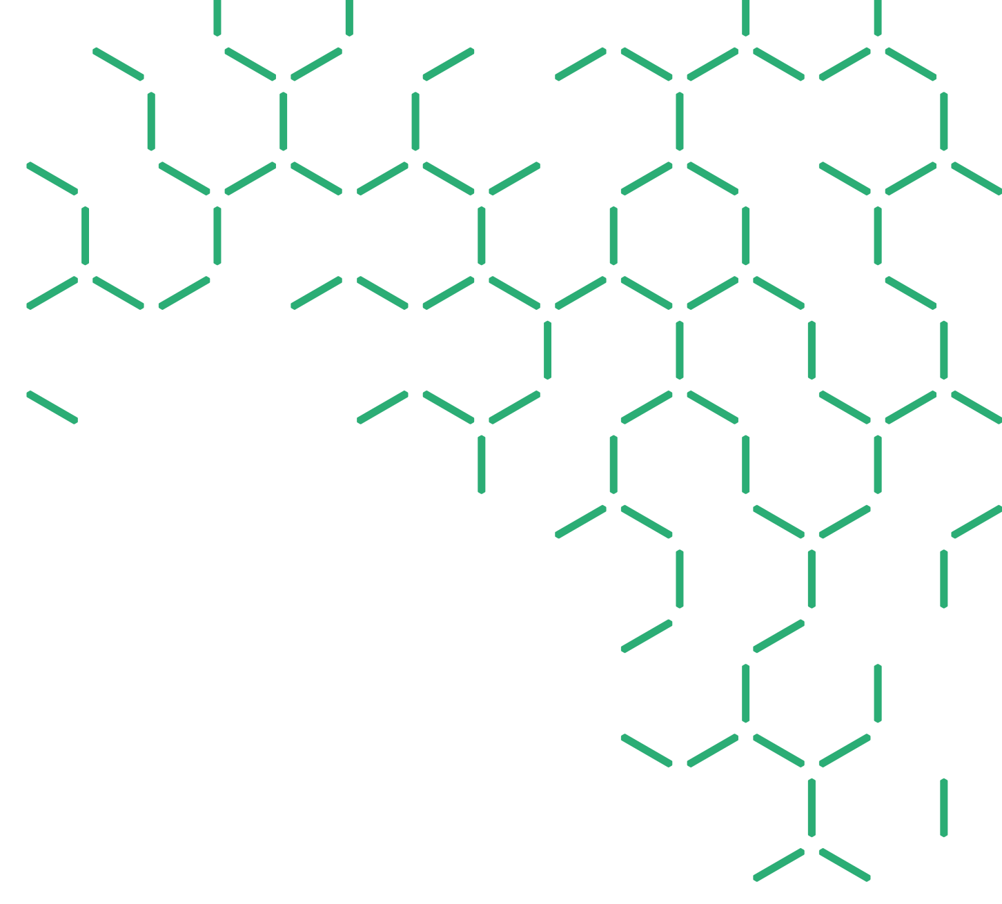
Computational Social Choice
as a Source of (Hard) Computational Problems
Nicholas Mattei | Senior Researcher
DATA 61 and UNSW
www.csiro.au

Slide 2
Computational Social Choice as a Source of (Hard) Computational Problems
Nicholas Mattei
NICTA and UNSW

Slide 3
Computational Social Choice as a Source of (Hard) Computational Problems
Nicholas Mattei
Data 61 and UNSW

Slide 4
What This Talk IS About.
A personal high level view of ADT and ComSoc.
Some problems that are hard (computationally) are easy (practically).
Explore and exploit this trade space!
Some problems that are easy (computationally) are rare (practically).
Focus on those that are common!
Data and experiment are fundamental for interesting theory and demonstrating impact.

Slide 5
What This Talk Isn’t About
All aspects being covered at ADT including:
Multi-Criteria and General Optimization
All the different types of voting and domain restrictions.
Argumentation Frameworks
Learning and Decision Theory (kinda…)

Slide 6
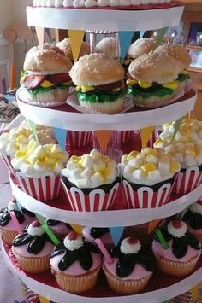
Social Choice
Agents with preferences and constraints over items …
1. Pick one or more of them as winner(s) for the entire group
OR....
2. Assign items to the agents in the group.
Subject to a number of exogenous goals, axioms, metrics, and/or constraints.
Notes:
Convert this to peer selection and/or cost sharing.

Slide 7
So What Are Constraints?
A constraint is a requirement.
Constraints limits the feasible space to a set of points where all constraints are satisfied.
Basic Computational Paradigm:
Set of Variables {X₁ … X_{n}} and domains {D₁ … D_{n}}.
Set of Constraints C(X₁, X₂) - a relation over D₁ X D_{2.}
Find an assignment to {X₁ … X_{n}} that is consistent.
Common in many applications:
Scheduling, time-tabling, routing, manufacturing…

Slide 8
So What Are Preferences?
A preference is a relation over the domain.
Set of Variables {X₁ … X_{n}} and domains {D₁ … D_{n}}.
A preference is a relationship over the elements of D_{i.}
Refine under constrained problems that admits many solutions.
Conditional
If we have two pizzas, I prefer a sausage and a bacon pizza, otherwise I prefer an extra cheese pizza.
Quantitative v. Qualitative
0.4 for sausage, 0.5 for bacon.
Sausage pizzas > bacon pizzas.
Positive
I like peperoni on my pizza.
Negative
I don’t like anchovies.
Unconditional
I prefer cheese.

Slide 9
Group Decisions
Technology enables larger and and more diverse sets of agents.
More conflict, more settings, more heterogeneity…
Lots of interesting domains!

Slide 10
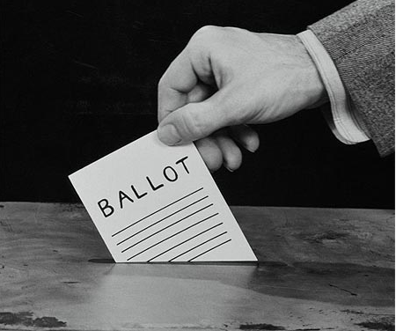
Voting and Ranking Systems
Voting has been used for thousands of years - many different elections systems which have been developed.
Used to select one or more alternatives that a group must share.
Peer Ranking Systems are the social choice setting where the set of agents and the set of choices is the same.

Slide 11
Markets and Mechanisms
Bidding, Auctions and Markets are other mechanisms used to aggregate the preferences of a collection of agents for an item or sets of items.
Usually require a central agent to collect the bids, announce a winner, collect the final price and in some cases, return value to the losing agents.

Slide 12
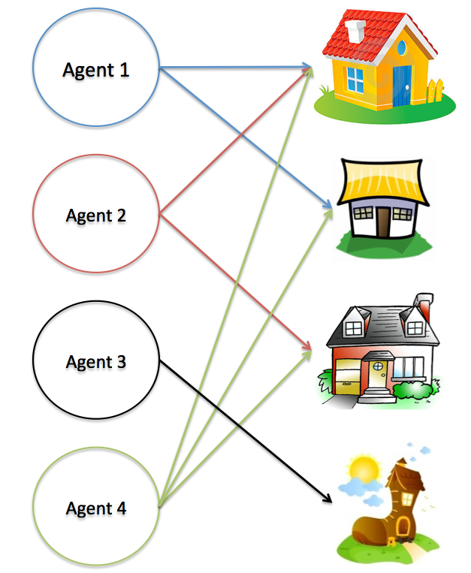
Matching and Assignment
Assign items from a finite set to the members of another set.
Kidneys for transplant.
Runways to airplanes.
Many axes to consider.
Divisible v. Indivisible Goods
Centralized v. Decentralized
Deterministic v. Random
Efficiency v. Fairness

Slide 13
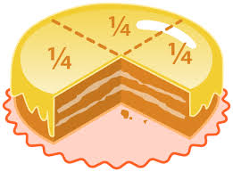
Cake Cutting
Given a divisible, heterogeneous resource (such as a cake) how do we divide portions among agents?
Use to allocate land, spectra, water access…
Many similar considerations:
Proportionality, fairness, no disposal, no crumbs…
Complementarities and other issues in preference.

Slide 14
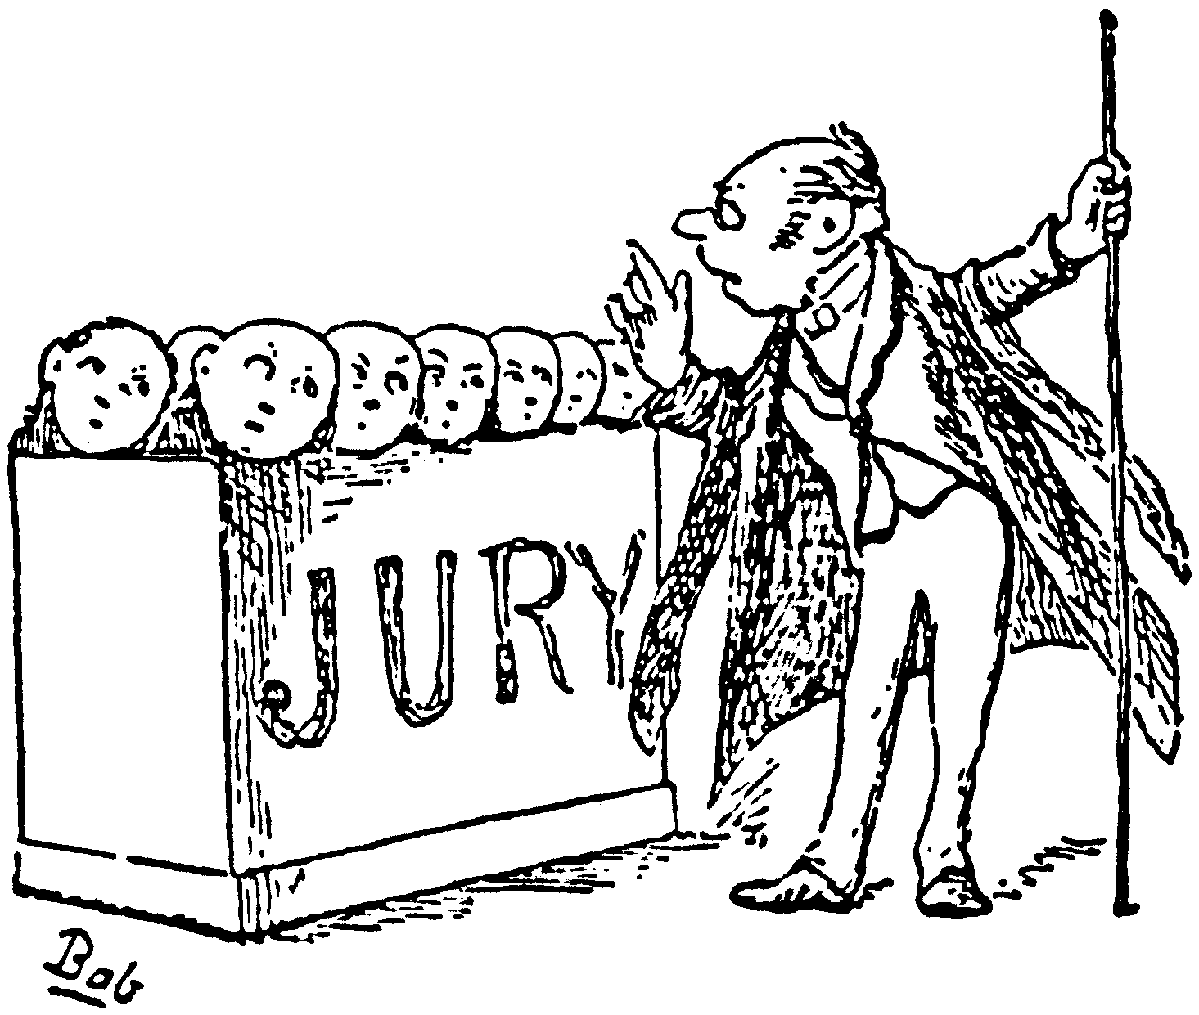
Judgment Aggregation and Belief Merging
Judgment Aggregation: Groups may need to aggregate judgments on interconnected propositions into a collective judgment.
Belief Merging: Groups may need to merging a set of individual beliefs or observations into a collective one.
Sounds close to LPNMR…

Slide 15
ADT and ComSoc
Algorithmic Decision Theory
&
Computational Social Choice
Economics & Psychology
Game Theory
Social Choice
Mechanism Design
Decision Theory
Computer Science
Complexity Theory
Artificial Intelligence
Optimization
Overview Article: Vincent Conitzer. Making Decisions Based on the Preferences
of Multiple Agents. Communications of the ACM (CACM), 2010
Notes:
Areas that we are dealing with

Slide 16
The “Useful Arts”…
Engineering (n):
The application of: mathematics, empirical evidence (experimental data) and scientific, economic, social, and practical knowledge in order to invent, design, build, maintain, research, and improve structures, machines, devices, systems, materials, and processes.
Notes:
An enginnering mindset – make things

Slide 17
ADT and ComSoc
Algorithmic Decision Theory
&
Computational Social Choice
Economics & Psychology
Game Theory
Social Choice
Mechanism Design
Decision Theory
Computer Science
Complexity Theory
Artificial Intelligence
Optimization
And…
Data
Learning
And…
Behavioral
Experimental
Overview Article: Vincent Conitzer. Making Decisions Based on the Preferences
of Multiple Agents. Communications of the ACM (CACM), 2010
Notes:
Areas that we are dealing with

Slide 18
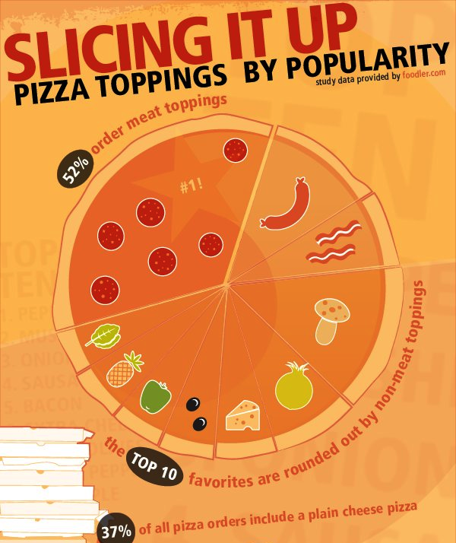
Notes:
Most popular pizza toppings – big pizza.

Slide 19
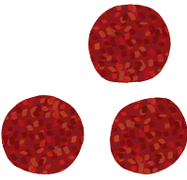
Complete Strict Orders
>
>
>
>
Every item appears once in the preference list.
All pairwise relations are complete, strict, and transitive.

Slide 20
Complete Orders with Indifference
>
>
>
~
Every item appears once in the preference list.
Pairwise ties are present.
We denote indifference with the ~ operator.
~

Slide 21
Incomplete Orders with Indifference
~
>
>
Not every item appears in the preference list.
Pairwise ties are present.

Slide 22
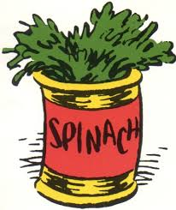
Complex Topping Options
Veg
Meat
Extra

Slide 23
CP-Nets
Veg | Spinach > Mushroom
Meat | Pepperoni > Bacon
Extra | Pepperoni: Olives > Pineapple Bacon: Pineapple > Olives
[Spinach, Pepperoni ,Olives]
[Spinach, Pepperoni ,Pineapple]
Veg
[Mushroom, Pepperoni ,Olives]
[Spinach, Bacon, Pineapple]
Meat
[Mushroom, Pepperoni ,Pineapple]
[Spinach, Bacon, Olives]
[Mushroom, Bacon, Pineapple]
Extra
[Mushroom,Bacon,Olives]

Slide 24
Numerical Preferences (Utility)
= 5.0
= 0.1
= 0.001
= 0.0
= 10.0
= 22.5764
Notes:
Complimentarities – make this more concrete on transition.

Slide 25
Voting
In general, we define an election as:
A set of alternatives, or candidates C of size m.
A set of agents A of size n.
For each i in V a preference over C.
All together, called a profile, P.
A resolute voting rule selects a single winner from C.
A voting correspondence selects a set of winners from C.
A social welfare function returns an ranking over C.

Slide 26
Assignment
In general, we define an assignment setting as:
A set of objects, O of size m.
A set of agents A of size n.
For each i in V a preference over O.
All together, called a profile, P.
An assignment mechanism assigns the objects in O to A.
A fractional (randomized) mechanism assigns fractions (or probability mass) of the objects in O to A.

Slide 27
Coalitional Manipulation
Candidates
Bacon | Pepperoni
Olives | Mushroom
Can an agent or group of agents misrepresent their preferences in such a ways as to obtain a better result?
Count | Vote
49 | B > O > P > M
20 | O > P > B > M
20 | O > B > P > M
11 | P > O > B > M
Bacon

Slide 28
Coalitional Manipulation
Candidates
Bacon | Pepperoni
Olives | Mushroom
Can an agent or group of agents misrepresent their preferences in such a ways as to obtain a better result?
Count | Vote
49 | B > O > P > M
20 | O > P > B > M
20 | O > B > P > M
11 | O > P > B > M
Olive!

Slide 29
Coalitional Manipulation
Candidates
Bacon | Pepperoni
Olives | Mushroom
Can an agent or group of agents misrepresent their preferences in such a ways as to obtain a better result?
We generally make worst case assumptions:
Manipulator(s) know all.
Tie-breaking favors them.
Preferences are complete.
Count | Vote
49 | B > O > P > M
20 | O > P > B > M
20 | O > B > P > M
11 | O > P > B > M

Slide 30
Coalitional Manipulation Results!
Voting Rule | One Manipulator | At Least 2
Copeland | Polynomial | NP-Complete
STV | Polynomial | NP-Complete
Veto | Polynomial | Polynomial
Plurality with Runoff | Polynomial | Polynomial
Cup | Polynomial | Polynomial
Borda | Polynomial | NP-Complete
Maximin | Polynomial | NP-Complete
Ranked Pairs | NP-Complete | NP-Complete
Bucklin | Polynomial | Polynomial
Nanson’s Rule | NP-Complete | NP-Complete
Baldwin’s Rule | NP-Complete | NP-Complete
Many of these appeared in top AI (AAAI, IJCAI, etc.)
Thanks to Lirong Xia for the table!

Slide 31
Notes:
Other groups have these tool chains that allow deployed stuff.

Slide 32
www.preflib.org
Toby Walsh
Notes:
Mention data types; Election data, matching data, rating/combinatorial, numerical
Free and open
Tools as well

Slide 33
Challenges
Variety
We need lots of examples from many domains.
Elicitation
How do we collect and ensure quality?
Modeling
What are the correct formalisms?
Over-fitting
Can we be too focused?
Privacy and Information Silos
Some data cannot or will not be shared…

Slide 34
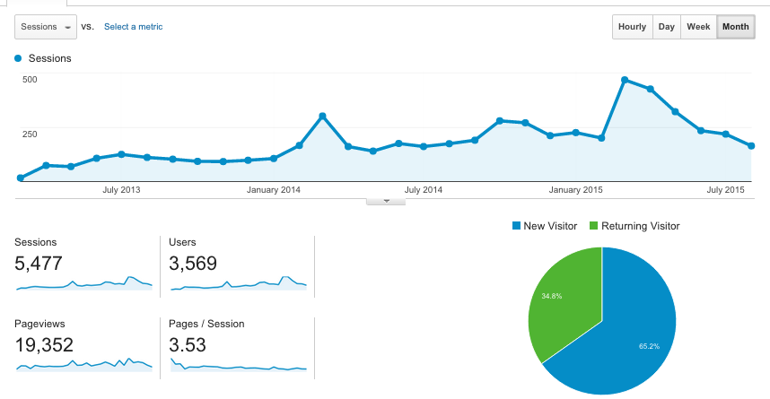
Since March 2013
Notes:
Highlight explore.

Slide 35
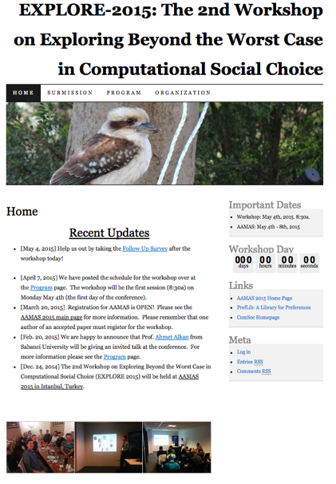
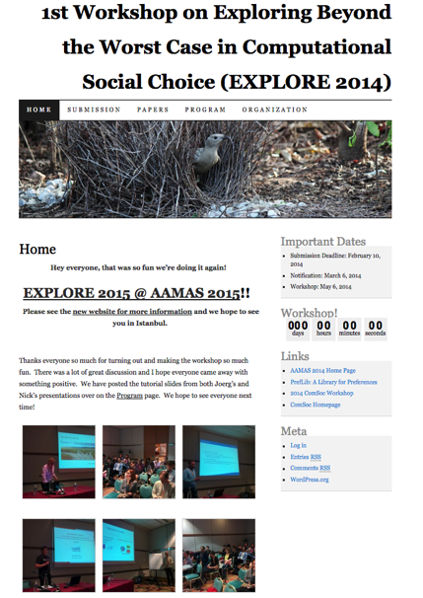
Since March 2013
EXPLORE 2015
EXPLORE 2014
Notes:
Highlight explore.

Slide 36
Preferences and Data
>
>
>
>
Every item appears once in the preference list.
All pairwise relations are complete, strict, and transitive.
Election and Matching data types.
Comma separated lists.

Slide 37
Closer…
>
>
Not every item appears in the preference list.
Pairwise ties are present.

Slide 38
Reality…
>
>
>
Not every item appears in the preference list.
Pairwise ties are present.

Slide 39
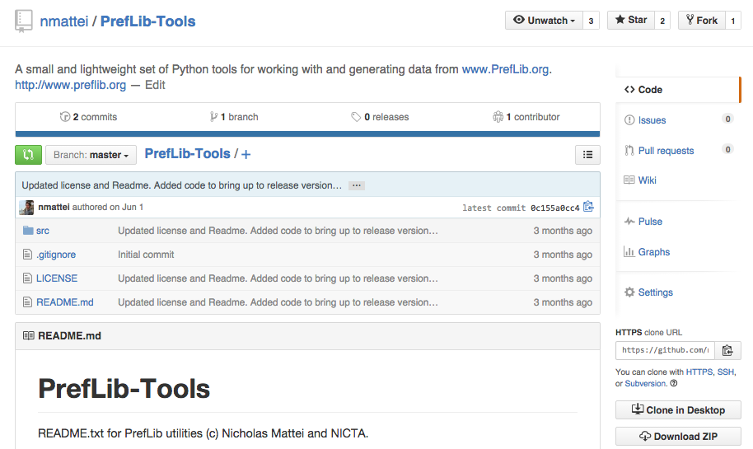
Tools on GitHub
Notes:
Read, write, modify, extend, domain, generate 6 standard models.

Slide 40
Model Dependent Effects!
Behavioral aspects have substantial impact
No single peaked profiles in Preflib!
Majority of the orders are incomplete!
Youtube’s dropping of the star ratings system…
Dropping non-responders…
Pay particular attention to the domain!
Acutely aware of model dependence.
Use principled generators that map to domains of interest!
Notes:
Remember where the data came from!!!

Slide 41
Model Dependence and Allocation
Elicitation methods are especially importation in allocation methods.
Most models can cause implicit or explicit trades between complexity, expressivity, and, quality.
Haris Aziz
Renee Noble
Notes:
And we do this all the time….

Slide 42
Conference Paper Assignment!
Each reviewer has a capacity.
Each paper has a capacity.
Reviewers
Papers
Group activity selection, task assignment…
Question: Really assigning Chores!
Notes:
This is why we allow negitive weights!

Slide 43
Domain Restrictions
Notes:
Garg claims that: In fact, Easychair’s automatic assignment feature computes a maximum weight assignment w.r.t. the weight function w(i) = i.

Slide 44
Domain Restrictions
Black Box We do not provide information on how paper assignment in EasyChair is implemented. The information in Garg et.al. may be incorrect or out of date - none of the authors worked for EasyChair, they also had no access to the EasyChair code. Best regards, EasyChair Support Team
Notes:
Garg claims that: In fact, Easychair’s automatic assignment feature computes a maximum weight assignment w.r.t. the weight function w(i) = i.

Slide 45
Ordering Lunch
X | X | X | X | X
X |  | X | X | X
X |  |  | X | X
 |  |  |  | X | X | X
 |  |  |  | X | X

Slide 46
Models - Pessimistic
>
>
>

Slide 47
Models – Anchor and Adjust
>
>

Slide 48
Ordering Lunch (Ranks)
1 | 1 | 2 | 3 | 5
2 |  | 1 | 2 | 4
3 |  |  | 1 | 3
 |  |  |  | 1 | 1 | 1
 |  |  |  | 2 | 2
Notes:
Australian pineapples.

Slide 49
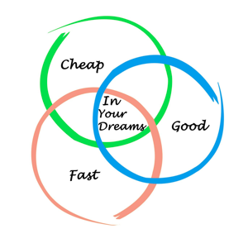
Trade Space in Allocation
Allocations domains (esp. egalitarianism or fair share properties) seem interesting places to study model dependent effects.
Interesting direction for future work both axiomatically, computationally, and practically.

Slide 50
Conclusions
Use theory, data, and experiment to develop and deploy solutions and enable new theory.
Exciting hard (computationally) and common (practically) problems yet to be explored in voting, resource allocation, and beyond.

Slide 51
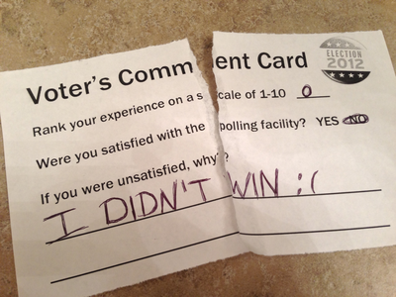
Thanks!
Questions
Comments

