Slide 1


Network & Security
An introduction
Prof. Giovambattista Ianni
Università della Calabria
Dott. Francesco Pacenza
Università della Calabria
Notes:
TODO: mettere i requisiti che desideriamo da ogni tipologia di protocollo
(Es.: lo scambio di chiave deve essere confidenziale ecc ecc)

Slide 2
Information
6 ECTS (4 Theory + 2 Lab = 32+24 hours)
Suggested material:
-W. Stallings, Cryptography and Network Security, 7th – 8th edition
-W. Stallings, Computer Security: Principles and Practice (4th ed.)
-Online material
Required skills:
Operating Systems, Computer Networks, Databases, Web Information Systems, Scripting and programming
In other words, a bachelor degree in Computer Science

Slide 3






Exam procedure
Talk on a selected topic
The talk must include a live demo
Oral exam
TEACHING TEAM
Prof. G. Ianni
F. Pacenza, Ph. D.
OFFICE HOURS
GB Ianni: Tuesday 15:00
Francesco: on appointment
Course
Material
Course
Team
Course
FB

Slide 4



Course Program
Part 1: Cryptography on the field
  Hashing, Asymmetric and Symmetric Cryptography, PKI
Part 2: a travel into the security aspects of the TCP/IP stack

Slide 5
Part 1
A dictionary of buzzwords

Slide 6
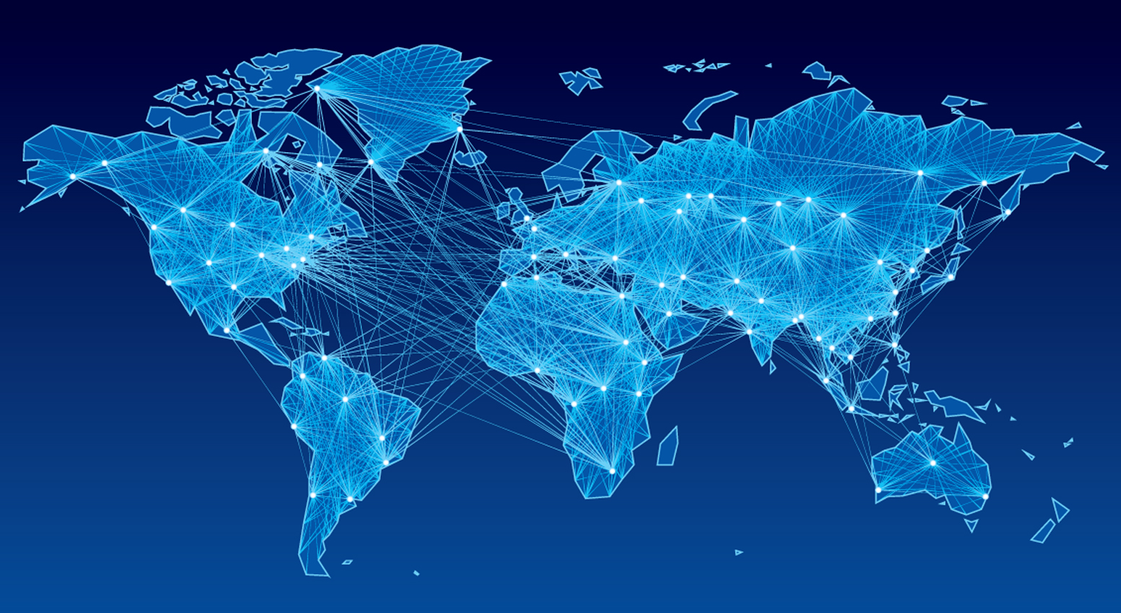


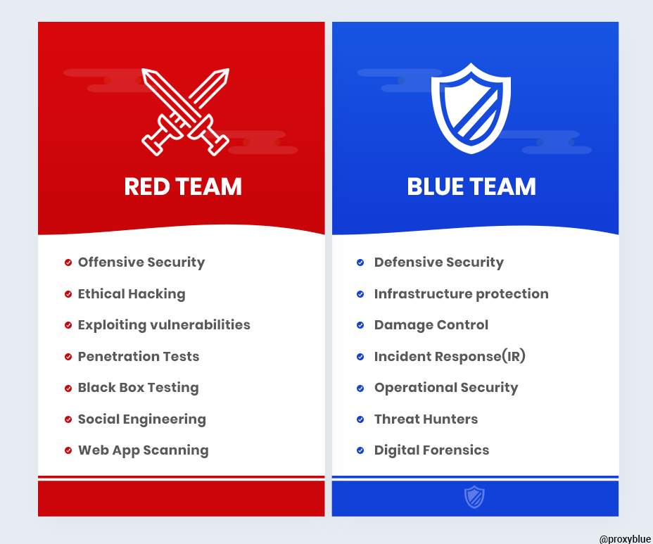
DICTIONARY - I
Who/what sits in the playfield:
  Computers
  Networks
  Humans (stupid and not stupid ones)
The players:
  Attackers:
  black and white hackers
  [Red & Purple Team]
  Defenders:
  sysadmins,
  programmers,
  users [Blue Team]

Slide 7
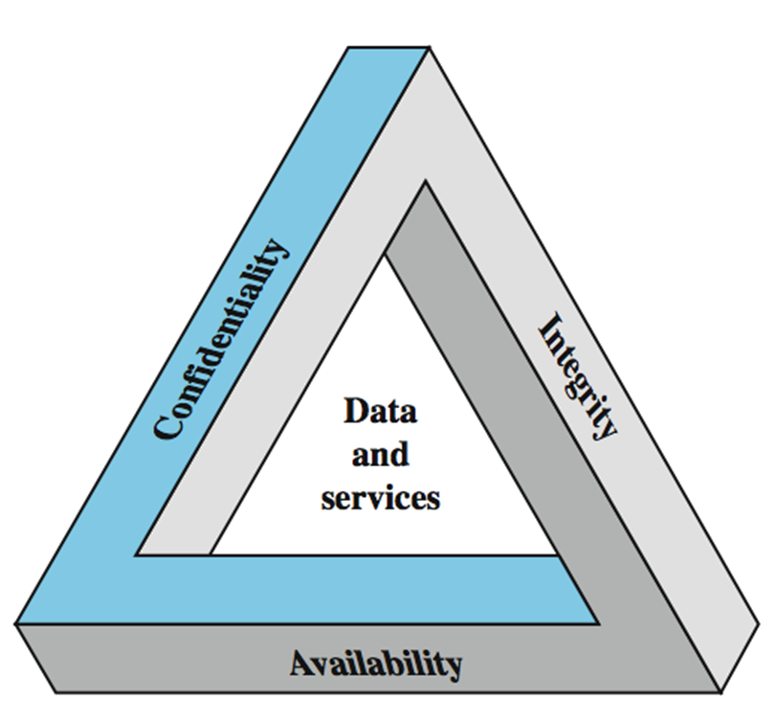
Key Security Concepts
Notes:
These three concepts form what is often referred to as the CIA triad (Figure 1.1). The three concepts embody the fundamental security objectives for both data and for information and computing services. FIPS PUB 199 provides a useful characterization of these three objectives in terms of requirements and the definition of a loss of security in each category:
• Confidentiality (covers both data confidentiality and privacy): preserving authorized restrictions on information access and disclosure, including means for protecting personal privacy and proprietary information. A loss of confidentiality is the unauthorized disclosure of information.
• Integrity (covers both data and system integrity): Guarding against improper information modification or destruction, and includes ensuring information non-repudiation and authenticity. A loss of integrity is the unauthorized modification or destruction of information.
• Availability: Ensuring timely and reliable access to and use of information. A loss of availability is the disruption of access to or use of information or an information system.
Although the use of the CIA triad to define security objectives is well established, some in the security field feel that additional concepts are needed to present a complete picture. Two of the most commonly mentioned are:
• Authenticity: The property of being genuine and being able to be verified and trusted; confidence in the validity of a transmission, a message, or message originator.
• Accountability: The security goal that generates the requirement for actions of an entity to be traced uniquely to that entity.

Slide 8
DICTIONARY - II
The possible moves (Attack types):
  Attacks to integrity
    Data counterfeiting, identity theft
    Authenticity, accountability, non-repudiation
  Attacks to confidentiality
    Weak and strong information theft
  Attacks to the quality of service
    (Distributed) Denial of service: DDoS
Attack surface – Defense Perimeter
Domino effect - Pivoting connects all the above

Slide 9
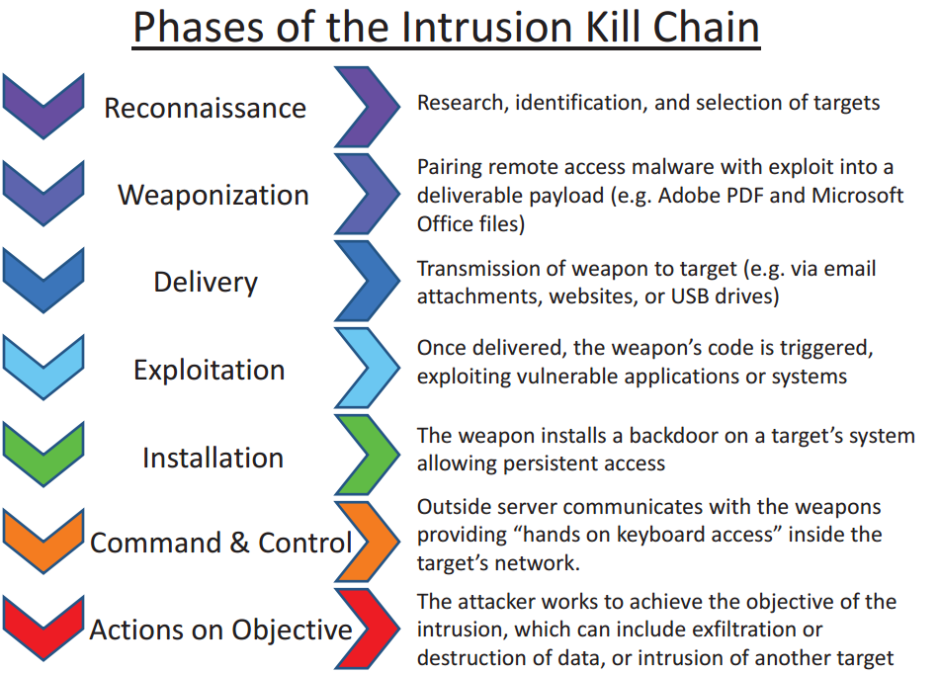

Slide 10
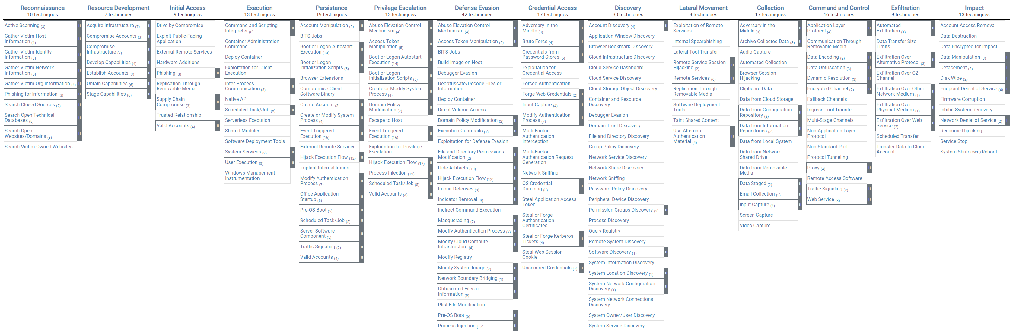
ATT&CK Matrix from MITRE
https://attack.mitre.org/

Slide 11
DICTIONARY – III (RfC 2828)
consider 3 aspects of information security:
  security attack
  security mechanism (detection, prevention, recover)
  security service
note terms
  weakness – a general conduct which may lead to generation of threats
  threat/vulnerability – a specific potential for violation of security
  attack – an assault on system security, a deliberate attempt to evade security services
Notes:
The OSI security architecture focuses on security attacks, mechanisms, and services. These can be defined briefly as follows:
• Security attack: Any action that compromises the security of information owned by an organization.
• Security mechanism: A process (or a device incorporating such a process) that is designed to detect, prevent, or recover from a security attack.
• Security service: A processing or communication service that enhances the security of the data processing systems and the information transfers of an organization. The services are intended to counter security attacks, and they make use of one or more security mechanisms to provide the service.
In the literature, the terms threat and attack are commonly used to mean more or less the same thing. Table 1.1 provides definitions taken from RFC 2828, Internet Security Glossary.
Threat - A potential for violation of security, which exists when there is a circumstance, capability, action, or event that could breach security and cause harm. That is, a threat is a possible danger that might exploit a vulnerability.
Attack - An assault on system security that derives from an intelligent threat; that is, an intelligent act that is a deliberate attempt (especially in the sense of a method or technique) to evade security services and violate the security policy of a system.

Slide 13
WEAKNESS – EXAMPLE - CWEs
CWE-22 | Improper Limitation of a Pathname to a Restricted Directory ('Path Traversal')
  The software uses external input to construct a pathname that is intended to identify a file or directory that is located underneath a restricted parent directory, but the software does not properly neutralize special elements within the pathname that can cause the pathname to resolve to a location that is outside of the restricted directory.
Notes:
INSERIRE ESEMPIO

Slide 14
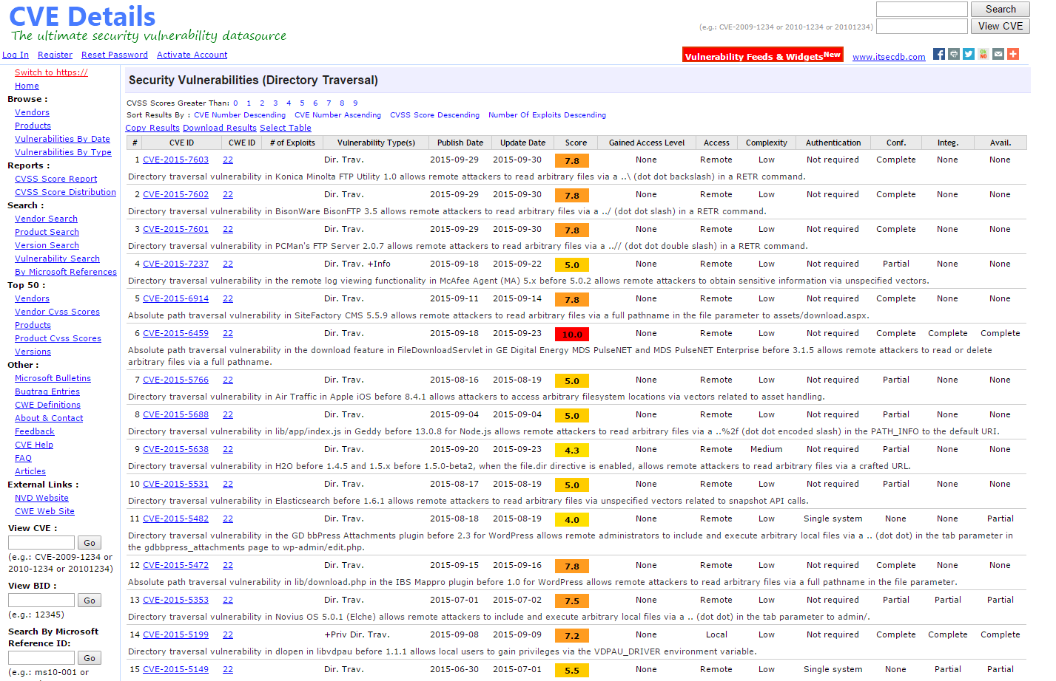
THREAT – EXAMPLE - CVEs
Some known Path traversal cases:
  http://goo.gl/88zUlr

Slide 15
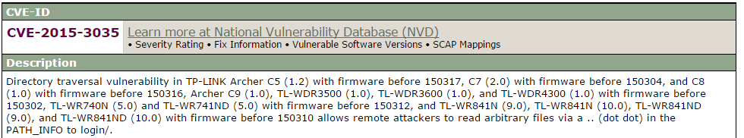
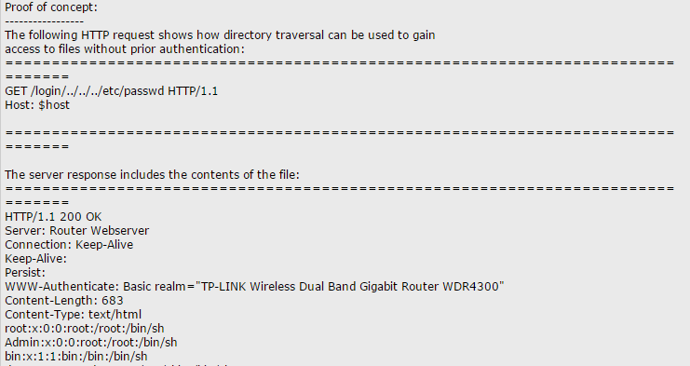
ATTACK - EXAMPLE
Notes:
Cve: http://cve.mitre.org/cgi-bin/cvename.cgi?name=CVE-2015-3035
Example: http://www.securityfocus.com/archive/1/archive/1/535240/100/0/threaded

Slide 16
Part 2
False myths

Slide 17
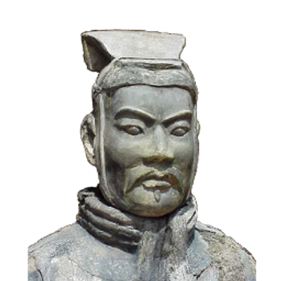
The art of war teaches us to rely not on the likelihood of the enemy's not coming, but on our own readiness to receive him; not on the chance of his not attacking, but rather on the fact that we have made our position unassailable.
—The Art of War, Sun Tzu
Notes:
This quote from the start of Ch0 ”Reader’s Guide” sets the scene for why we want to study these issues.

Slide 18
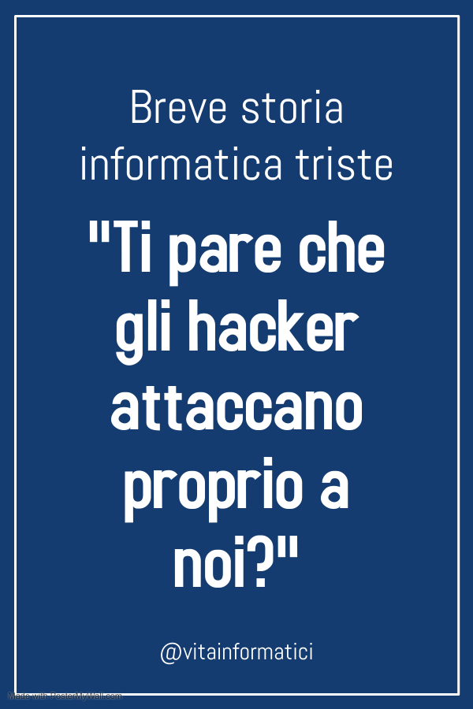
Some false myths:
Myth 1
  False optimism: «admin/admin is ok as login.
  Who’s gonna ever attack me»
Myth 2
  False pessimism: «Tanto se me lo vogliono bucare me lo bucano»
  «Why to put security countermeasures. They’ll hack me anyway if they want»
Myth 3
  «A too secure infrastructure will challenge hackers. They will be attired to my server like mosquitoes on a purple lamp»

Slide 19
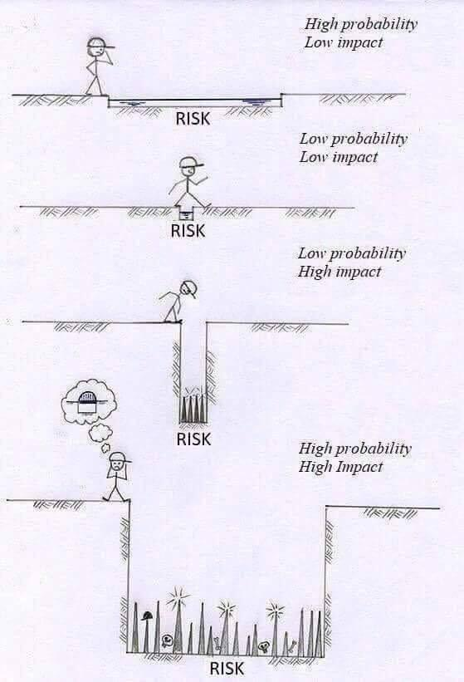
Risk estimate
Risk =
  Probability x Gravity
Gravity =
  Involved people x single cost
ISO 31000:2018
  Risk management
ISO 2700X:2018

Slide 20
Risk mitigation: two different attack perspectives
Massive attack campaigns
  You don’t care about specific victims, you scan among millions of targets
  Attackers do not exploit specific information about the victims
Targeted attacks
  You aim to specific users/companies/perimeters
  Attackers can (and do) exploit specific information about the victims

Slide 21
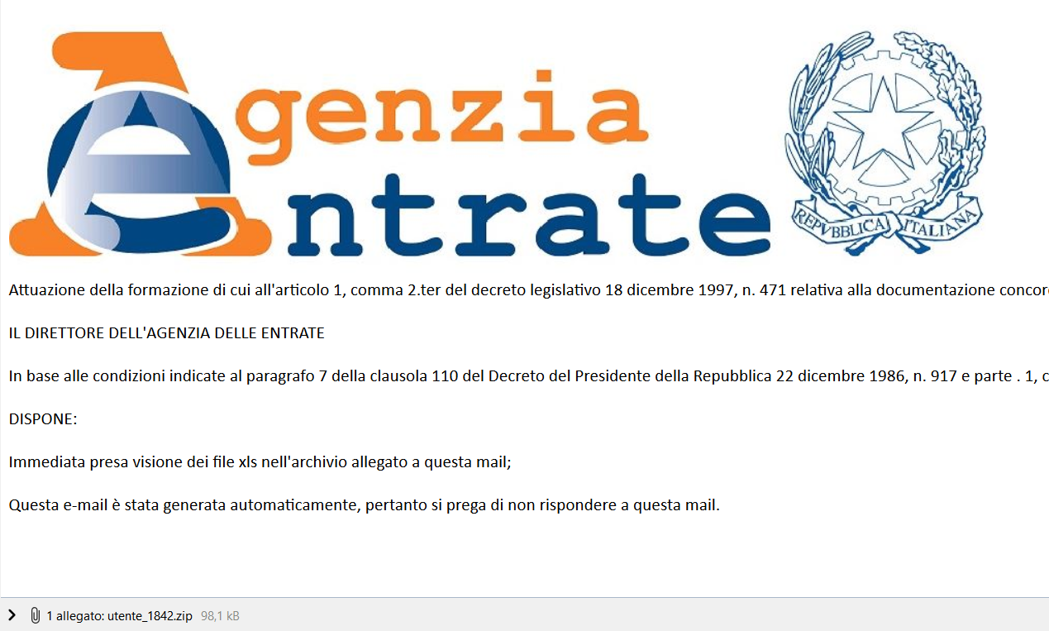
Example of massive attack: phishing
Attackers use bluffs hinting at a targeted attack (it is not)

Slide 22
Risk mitigation: example
Hard drive encryption
  It reduces part of data theft attack surface
Biometric authentication
  Prevents some forms of password theft
Firewalls
  They block part of unwanted traffic
Exercise: choose one security mechanism and analyze its risk mitigation profile

Slide 23
PARANOID vs unsecured
Estimated Money loss per year due to security breaches in your company (economic risk) = L
Estimated cost of mitigation (new firewalls, etc.) = S
Estimated Money loss per year due to uncontrolled system administrator/programmers paranoidism = D
L > S+D
D
L
€€€€
S
€€

Slide 24
Computer Security Challenges
not simple
must consider potential attacks
procedures used counter-intuitive
involve algorithms and secret info
must decide where to deploy mechanisms
battle of wits between attacker / admin
not perceived on benefit until fails
requires regular monitoring
too often an after-thought
regarded as impediment to using system
Notes:
Computer security is both fascinating and complex. Some of the reasons follow:
1. Computer security is not as simple as it might first appear to the novice. The requirements seem to be straightforward, but the mechanisms used to meet those requirements can be quite complex and subtle.
2. In developing a particular security mechanism or algorithm, one must always consider potential attacks (often unexpected) on those security features.
3. Hence procedures used to provide particular services are often counterintuitive.
4. Having designed various security mechanisms, it is necessary to decide where to use them.
5. Security mechanisms typically involve more than a particular algorithm or protocol, but also require participants to have secret information, leading to issues of creation, distribution, and protection of that secret information.
6. Computer security is essentially a battle of wits between a perpetrator who tries to find holes and the designer or administrator who tries to close them.
7. There is a natural tendency on the part of users and system managers to perceive little benefit from security investment until a security failure occurs.
8. Security requires regular monitoring, difficult in today's short-term environment.
9. Security is still too often an afterthought - incorporated after the design is complete.
10. Many users / security administrators view strong security as an impediment to efficient and user-friendly operation of an information system or use of information.

Slide 25
Part 3
Battlefields

Slide 26
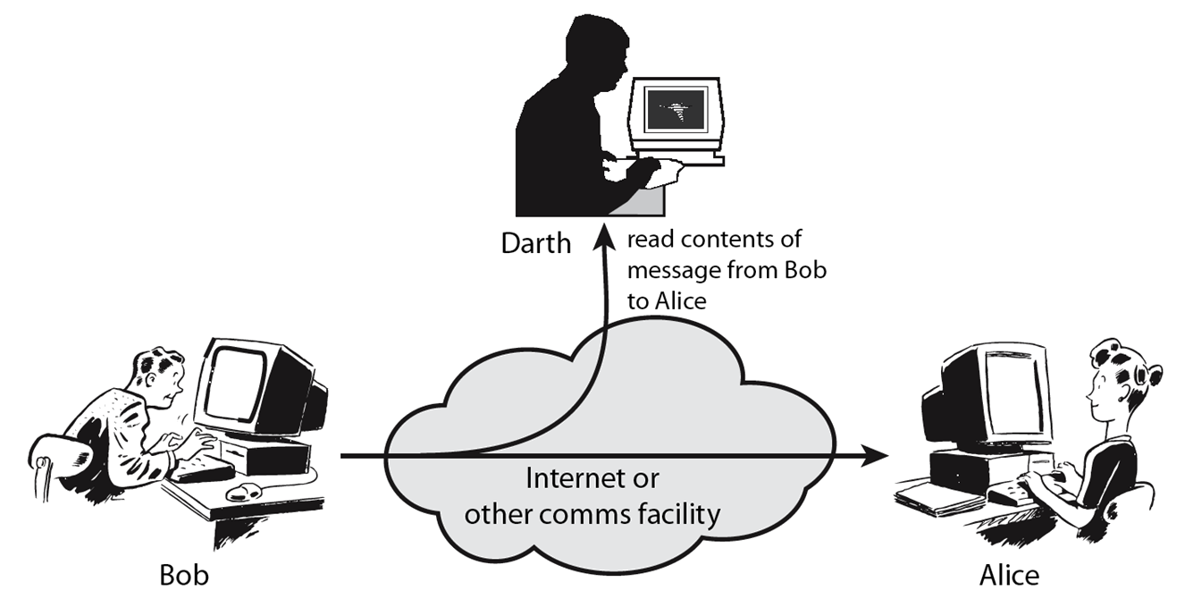
Passive Attacks
Notes:
A useful means of classifying security attacks, used both in X.800 and RFC 2828, is in terms of passive attacks and active attacks. A passive attack attempts to learn or make use of information from the system but does not affect system resources.
Passive attacks are in the nature of eavesdropping on, or monitoring of, transmissions. The goal of the opponent is to obtain information that is being transmitted. Two types of passive attacks are:
+ release of message contents - as shown above in Stallings Figure 1.2a here
+ traffic analysis - monitor traffic flow to determine location and identity of communicating hosts and could observe the frequency and length of messages being exchanged
These attacks are difficult to detect because they do not involve any alteration of the data.

Slide 27
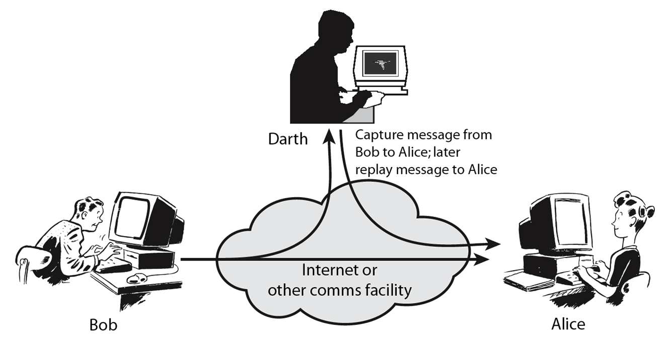
Active Attacks
Notes:
Active attacks involve some modification of the data stream or the creation of a false stream and can be subdivided into four categories: masquerade, replay, modification of messages, and denial of service:
masquerade of one entity as some other
replay previous messages (as shown above in Stallings Figure 1.3b)
modify/alter (part of) messages in transit to produce an unauthorized effect
denial of service - prevents or inhibits the normal use or management of communications facilities
Active attacks present the opposite characteristics of passive attacks. Whereas passive attacks are difficult to detect, measures are available to prevent their success. On the other hand, it is quite difficult to prevent active attacks absolutely, because of the wide variety of potential physical, software, and network vulnerabilities. Instead, the goal is to detect active attacks and to recover from any disruption or delays caused by them.

Slide 28
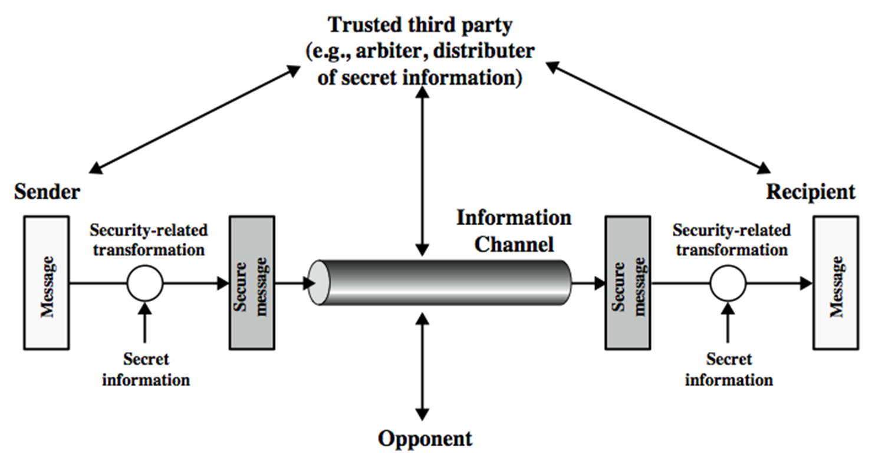
Model for Network Security
Notes:
In considering the place of encryption, its useful to use the following two models from Stallings section 1.6.
The first, illustrated in Figure 1.4, models information being transferred from one party to another over an insecure communications channel, in the presence of possible opponents. The two parties, who are the principals in this transaction, must cooperate for the exchange to take place. They can use an appropriate security transform (encryption algorithm), with suitable keys, possibly negotiated using the presence of a trusted third party. Parts One through Four of this book concentrates on the types of security mechanisms and services that fit into the model shown here.

Slide 29
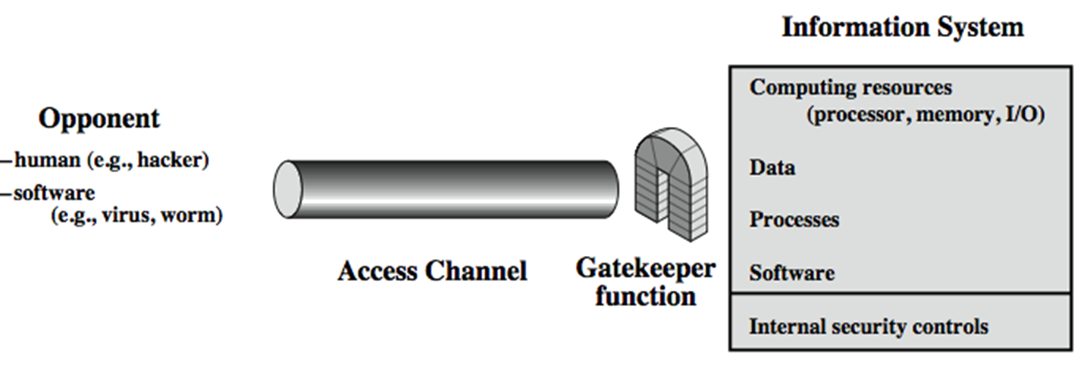
Model for Network Access Security
Notes:
The second, illustrated in Figure 1.5, model is concerned with controlled access to information or resources on a computer system, in the presence of possible opponents. Here appropriate controls are needed on the access to and within the system, to provide suitable security.
The security mechanisms needed to cope with unwanted access fall into two broad categories (as shown in this figure). The first category might be termed a gatekeeper function. It includes password-based login procedures that are designed to deny access to all but authorized users and screening logic that is designed to detect and reject worms, viruses, and other similar attacks. Once either an unwanted user or unwanted software gains access, the second line of defense consists of a variety of internal controls that monitor activity and analyze stored information in an attempt to detect the presence of unwanted intruders. These issues are explored in Part Four.

Slide 31
Part 4
Other FAQs

Slide 32
Ethical Issues: can I «check» someone else’s system with no authorization?
NO: it’s a trespassing crime in almost any law in the planet
Art. 614 codice penale: chiunque s'introduce nell'abitazione altrui, o in un altro luogo di privata dimora, o nelle appartenenze di essi, contro la volontà espressa o tacita di chi ha il diritto di escluderlo, ovvero vi s'introduce clandestinamente o con inganno, è punito con la reclusione da sei mesi a tre anni
Art. 615 ter codice penale: chiunque abusivamente si introduce in un sistema informatico o telematico protetto da misure di sicurezza ovvero vi si mantiene contro la volontà espressa o tacita di chi ha il diritto di escluderlo, è punito con la reclusione fino a tre anni. […]

Slide 33

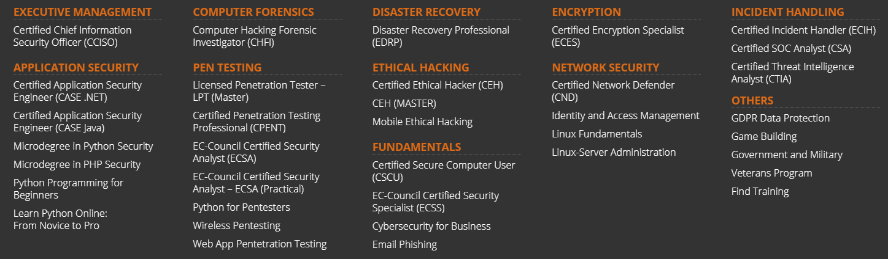
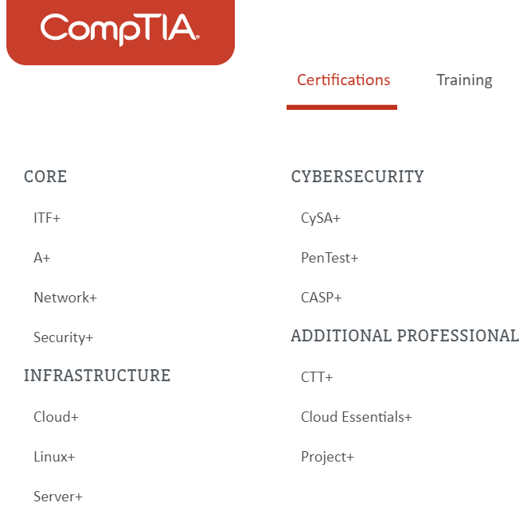

FAQ: Professional certifications
EC-COUNCIL CEH (EC Certified Ethical Hacker)
OSCP (Offensive Security Certified Professional – Kali based)

Slide 34
Security guidelines
It depends on what you want to protect!
  ISO 27001
  ISO 27017 (Cloud security),
  ISO 27018 (Personal Information Protection)
  CCSC, USCGB.
  Italian «Linee guida AGID»

