Slide 1

Password – based authentication,
Identity management
& Authentication protocols

Slide 2

Password Management workflow
Part - 1

Slide 3
Password-based authentication
Still very common
Pros:
  Cheap: easy to implement, passwords can be easily distributed and stored
  Security level is reasonable if all the password lifecycle is properly implemented
Reference Material: Stallings-Brown Computer Security, Chap. 3, International Edition

Slide 4
Password-based authentication - II
Cons:
  Proper password lifecycle implementations are rare (if they exist at all)
  There are security problem at each step of the password workflow
  Especially, the human factor is here crucial
"Humans are incapable of securely storing high-quality cryptographic keys, and they have unacceptable speed and accuracy when performing cryptographic operations. They are also large, expensive to maintain, difficult to manage, and they pollute the environment. It is astonishing that these devices continue to be manufactured and deployed. But they are sufficiently pervasive that we must design our protocols around their limitations. " -- Kaufman, Perlman, and Speciner quoted in Anderson's "Security Engineering"

Slide 5
Password workflow: context
Actors:
  A user with credentials (UID + Pass)
    Sometimes users are services themselves
  A service (Web server, OS, etc.)
  The user host, the server host, the transmission medium
Workflow
  User side storage
  Credential input
  Transmission
  Validation (Authentication stage)
  Server side storage

Slide 6
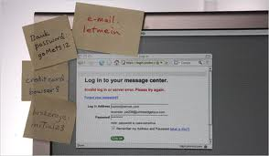
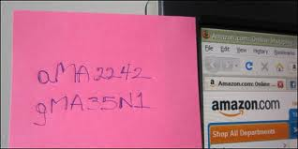
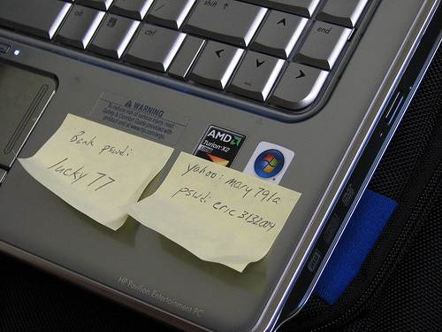
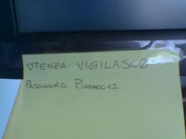
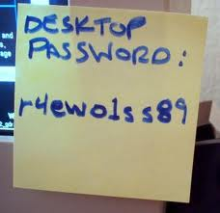
User SIDE storage
Storage must be reversible
Mental storage
Paper storage
Digital storage

Slide 7
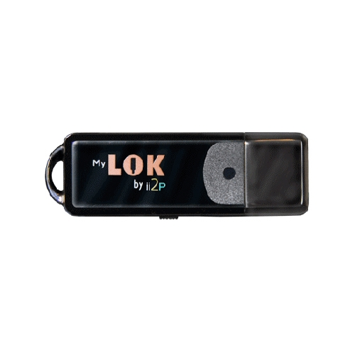
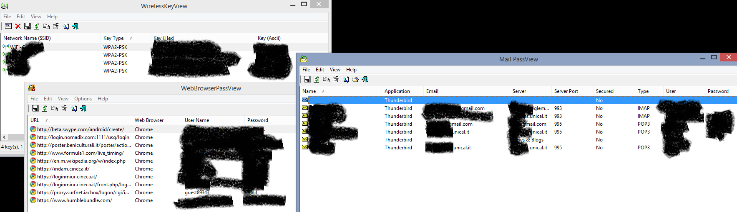
USER SIDE STORAGE - 2
Digital Storage
  Local password managers (Lastpass, Norton, Local Browser storage…)
    Pro: can avoid manual/mental storage;
    Cons: keystore password can be stolen/bruteforced
  USB Password Managers
    Pro: password are physically outsourced
    New U2F devices open new possibilities
  Browser and OS storages.. Poor.

Slide 8
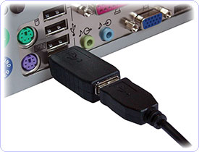
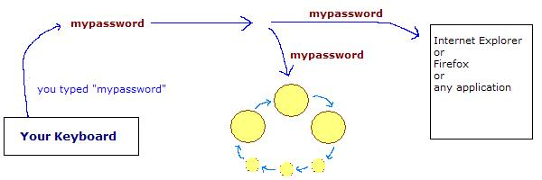
Input Stage
Keyloggers: HW & SW
  Anti-keylogger can mitigate the issue
  http://www.keylogger.org/, es. Relytec
Snooping – Direct and indirect
  Beware of who’s around you

Slide 9
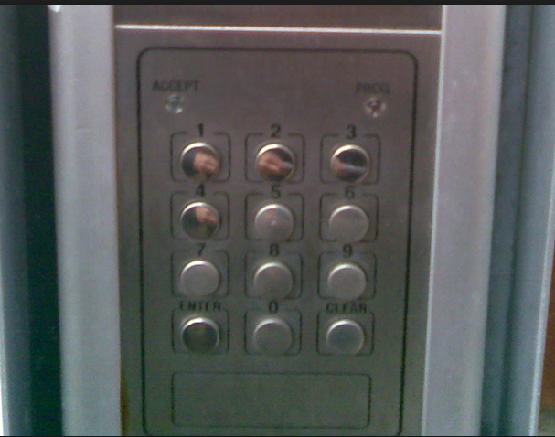
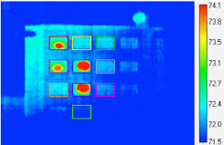
Thermal snooping & C.

Slide 10
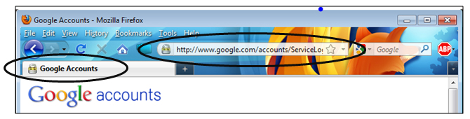

TRANSMISSION STAGE
Covering authentication with TLS/SSL:
  Recall that SSLSTRIP is still possible
Better using Challenge based protocols:
  Challenge based: HTTP digest, CHAP, MS-CHAPv2, EAP-SRP
And even better: combine TLS+Challenge, as in PEAP, etc..

Slide 11
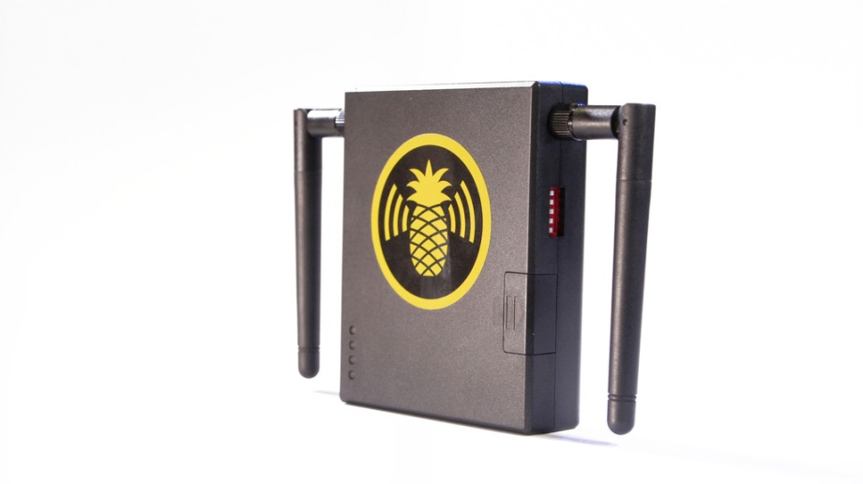
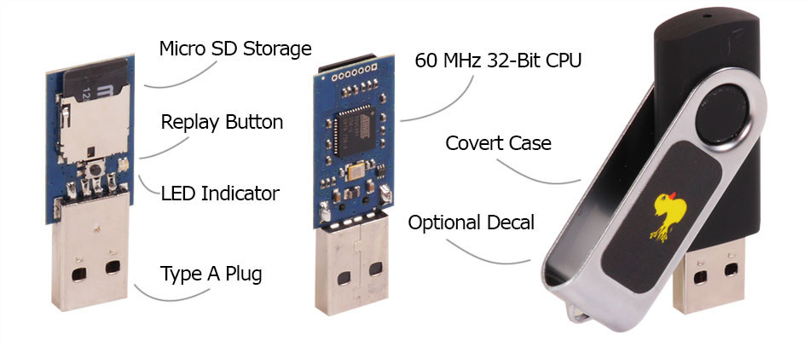
Other stealing channels
Phishing, especially
  SPEAR PHISHING
  Clone Phishing
Rogue APs, Bad USB pens…
Physical intrusions
€39.99
€99.99

Slide 12
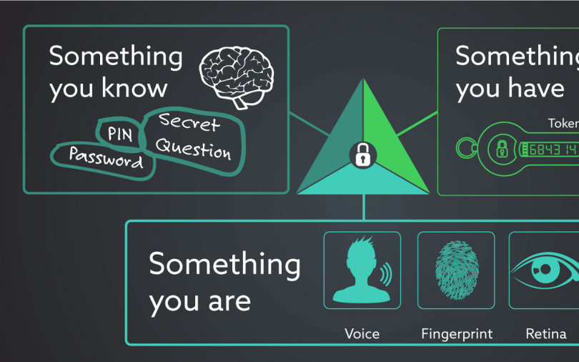
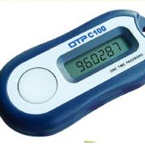
Mitigations:
Multi-Factor AUTH
Use multiple authentication means at once:
  Password
  OTP
    Sent via mobile
    Generated with a OTP device
  PKCS #11 device, U2F or other
  Pros: mitigate many stealing attacks
  Cons: might be cumbersome for the user

Slide 13
Password choice
Short or long?
  Long, but recall that a keylogger do not care about your password length!!
Common or uncommon?
Multiple passwords or just one?
Should a password be changed often?
Should the server provider enforce a password format and a password expiry window?
Is the ‘secret question’ a good password recovery mean?

Slide 14
Password Storage – server side
False myth: passwords do not need to be stored server-side in a reversible format
Use a good “salted” hash instead: for P, store <S,H^{n}(S+P)>
Brute forcing speed can be mitigated by iterating hashing multiple times (so, choose n=<thousands>)
Note that users with same password will noticeably have the same hash in the password file, if salt is not used
Login done using directly the password hash as a credential is not good practice
Windows password encryption schemes: http://technet.microsoft.com/en-us/library/cc512606.aspx

Slide 15
Password crackers
Rainbow table crackers (Ophcrack) use space
  http://ophcrack.sourceforge.net/tables.php
Mimikatz
Extremely effective for unsalted password storage
Incremental crackers (John the Ripper, Crack, LC5) use time and build dictionaries on-the-fly using password variations.

Slide 16
Rainbow Table ATTACKS
Build a dictionary with all the passwords which can be built, say, with ASCII words of 15 characters.
Compute the password hash of each of the above words. Index this table by hash value
You have now a rainbow table ready to go and distributable!
With a rainbow table, a brute forcing over a stolen password hash file is easy:
Just take an hash value h and lookup in the rainbow table!
Rainbow table attacks should not be possible on modern password storage schemes!

Slide 17
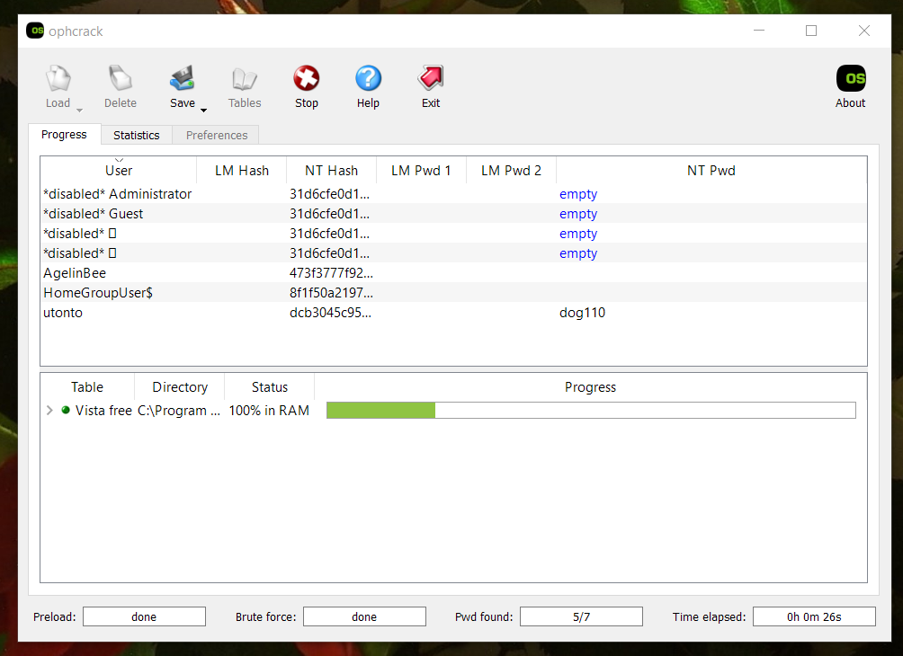

Slide 18
Rainbow tables - countermeasures
Easy to discourage this type of attack
Generate a nonce per each user (called salt)
Compute HASH(pass + salt)=H, store H + SALT
When validating take SALT from password table and compute HASH(pass’ + salt) (pass’ is the user input)
Even a 16 bit salt makes building rainbow tables unpractical (you need a 60’000 times larger table)
Linux password encryption: http://www.akkadia.org/drepper/SHA-crypt.txt

Slide 19
Programming Practice
Security related code should not be handled as you would do with normal code.
  Handling of security related material must respect tougher standards (see PCI DSS 3.0)
Technical bugs can be found relatively earlier, but security breaches can stay open for years!*
*We will not forget Log4shell for a long time
Keeping cleartext credentials within code is listed as weakness n.7 in the CWE Top weaknesses list

Slide 20
BAD HABITS Examples
Do it yourself “Salt”:
  hash = md5('deliciously-salty-' + password)
Disabling user accounts after 3 attempts exposes to denial of service;
Do it yourself password check within client-side code;
Do it yourself login;
Do not use broken hashing schemes like “md5”
  People know how to create MD5 conflicts
  Plain MD5 is TOO QUICK, and here speed is an enemy
  http://natmchugh.blogspot.it/2015/02/create-your-own-md5-collisions.html

Slide 21
Password storage DESIGN
Tradeoff:
  Store key’s hash value
    If the database of stored hashes is stolen, there won’t be directly visible passwords
    Nevertheless there is no way to know the clear text passwords, so to validate, the user must transmit them in the clear! (It would be no more secure anyway to transmit the password hash from client to server)
    The authentication has to be protected, for example with a DH scheme and some public-key authentication check
  Using a challenge-response protocol:
    on either side using a mathematical problem to prove respectively that you know the password but without transmitting the password unencrypted over the network
    These protocols work as long as both participants have access to the password unencrypted!
Either type of attack, database stealing and password phishing/sniffing/stealing can occur
  The theft of database can endanger an entire DB accounting archive

Slide 22
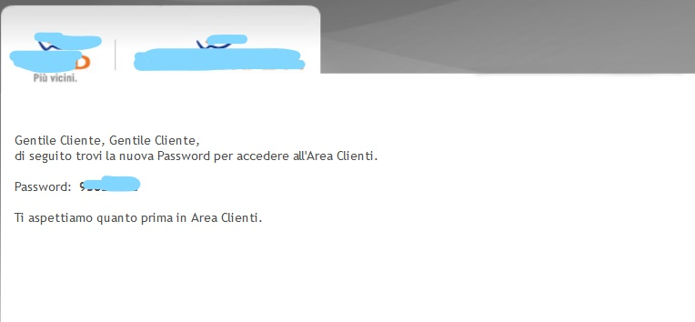
A long long road ahead…

Slide 23
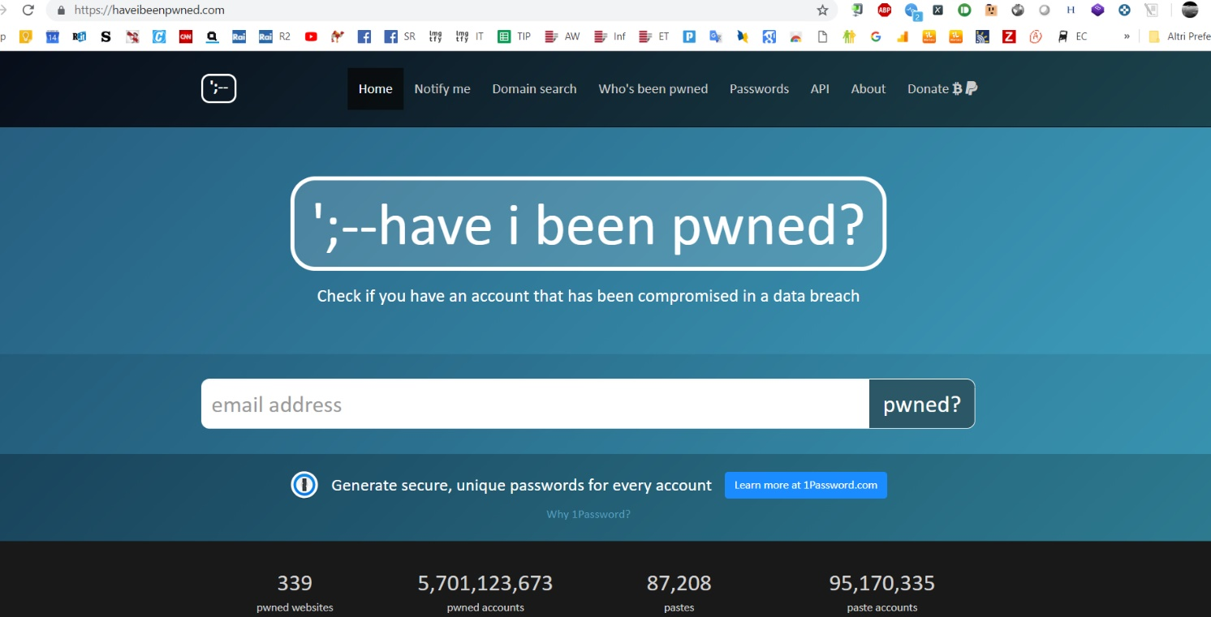
Is my password online?

Slide 24

Authentication
Part II

Slide 25
Authentication Protocols
PAP
CHAP & extensions (MS-CHAPv2)
Kerberos
PEAP/EAP
  LEAP, EAP-TLS, EAP-MD5, EAP-PSK, EAP-TTLS, EAP-IKEv2, EAP-FAST, EAP-SIM, EAP-AKA, EAP-GTC, EAP-EKE, EAP-MSCHAPv2
IKEv2 (Used for IPSec authentication)
HTTP – Digest (Used for HTTP auth, mostly only home appliances)
Rolling code based: keeloq (cars, gates..)
To directly use hash functions to authenticate and store passwords is a simple solution but as weak as using hash functions without salt, so it is to be avoided (CWE Weakness n. 25)

Slide 26
HTTP Basic access authentication
In the context of an HTTP transaction, this is a method for a web browser or other client program to provide a user name and password when making a request
  the user name is appended with a colon and concatenated with the password. The resulting string is encoded with the Base64 algorithm, for example:
    username Aladdin and password open sesame
    the string Aladdin:open sesame is Base64 encoded , resulting in QWxhZGRpbjpvcGVuIHNlc2FtZQ==

Slide 27
Basic access authentication
Encoded string is easily decoded
  Security is not the intent of the encoding step
  the intent of the encoding is to encode non-HTTP-compatible characters that may be in the user name or password into those that are HTTP-compatible

Slide 28
Advantages
All web browsers support it.
It is rarely used on publicly accessible Internet web sites but may sometimes be used by small, private systems, and in home appliances
  Programmers and system administrators sometimes use basic access authentication, in a trusted network environment, to manually test web servers using Telnet or other plain-text network tools

Slide 29
Disadvantages
It relies on the assumption that the connection between the client and server computers is secure and can be trusted
  if SSL/TLS is not used, then the credentials are passed as plaintext
  there is no effective way for a server to "log out" the user without closing the browser

Slide 30
Example
The client requests a page that requires authentication but does not provide a user name and password
the server responds with the 401 ("Unauthorized") response code, including the required authentication scheme and the authentication realm
the client will present the authentication realm (typically a description of the computer or system being accessed) to the user and prompt for a user name and password
once the user has supplied a user name and password, the client adds an Authorization header (with valuebase64encode(username+":"+password)) to the original request and re-sends it
the server accepts the authentication and the page is returned; if the user name is invalid or the password incorrect, the server might return the 401 response code

Slide 31
Example
Client request (no authentication):
GET /private/index.html HTTP/1.0 Host: localhost
Server response:
HTTP/1.0 401 Authorization Required
Server: HTTPd/1.0
Date: Sat, 27 Nov 2004 10:18:15 GMT
WWW-Authenticate: Basic realm="Secure Area"
Content-Type: text/html
Content-Length: 311
<!DOCTYPE HTML PUBLIC "-//W3C//DTD HTML 4.01 Transitional//EN" "http://www.w3.org/TR/1999/REC-html401-19991224/loose.dtd">
<HTML>
<HEAD>
<TITLE>Error</TITLE>
<META HTTP-EQUIV="Content-Type" CONTENT="text/html; charset=ISO-8859-1">
</HEAD>
<BODY><H1>401 Unauthorized.</H1></BODY>
</HTML>

Slide 32
Example
Client request (user name "Aladdin", password "open sesame"):
GET /private/index.html HTTP/1.0
Host: localhost
Authorization: Basic QWxhZGRpbjpvcGVuIHNlc2FtZQ==
Server response:
HTTP/1.0 200 OK Server: HTTPd/1.0
Date: Sat, 27 Nov 2004 10:19:07 GMT
Content-Type: text/html
Content-Length: 10476

Slide 33
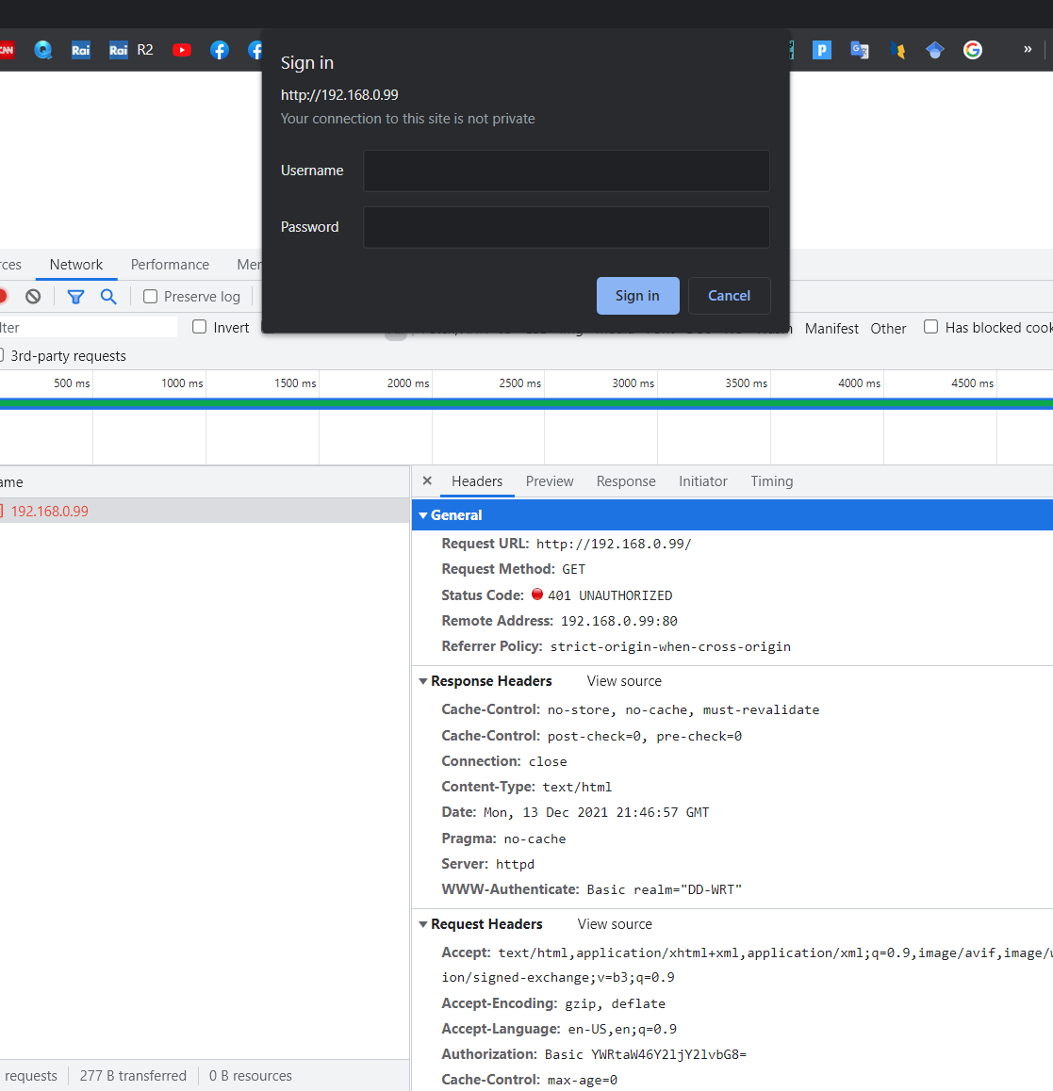

Slide 34
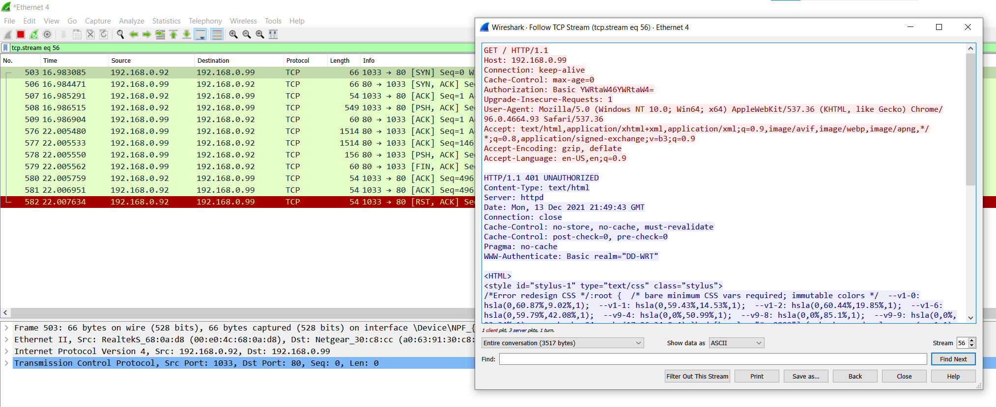

Slide 35
Autenticazione tipo CHAP
Solo i protocolli più stupidi prevedono il transito delle password in chiaro (è il caso di un POP3 malconfigurato)
Strano, ma è possibile dimostrare di conoscere le credenziali corrette senza trasmettere la password in chiaro
Come?

Slide 36
Autenticazione tipo CHAP
Esempio: password = ‘pinuzzu’
La password è conosciuta da client e server a priori
Solo se si conosce la password si può risolvere la challenge
Solution = SHA1(«pinuzzu»+ «34911»)
Authentication
request
Authentication
Challenge = ‘34911’
Challenge solution = “5697c2f8d9e7a0b8bfeba7d2e07e725b262920b1”
Ok!
tempo

Slide 37
HTTP Digest access authentication
Used to negotiate credentials with a user's web browser (using HTTP protocol).
  It applies a hash function to a password before sending it over the network, which is safer than basic access authentication, which sends plaintext
It is an application of MD5 cryptographic hashing with usage of nonce values to prevent cryptanalysis

Slide 38

RFC 2069

Slide 39
RFC 2617
If the qop (Quality of Protection) directive is "auth" or unspecified, HA2 is:
If the qop directive is "auth-int" , HA2 is:
If the qop directive is "auth" or "auth-int" , then compute the response as follows:
If the qop directive is unspecified, then compute the response as follows :

Slide 40
MD5 & Digest authentication
The MD5 calculations used in HTTP digest authentication is intended to be "one way"
  It should be difficult to determine the original input when only the output is known
  If the password itself is too simple, however, then it may be possible to test all possible inputs and find a matching output (a brute-force attack)

Slide 41
Advantages
HTTP digest authentication is designed to be more secure than traditional digest authentication schemes
  The password is not used directly in the digest, but rather HA1 = MD5(username:realm:password).
    This allows some implementations (e.g. JBoss^{[3]}) to store HA1 rather than the cleartext password
  Client nonce was introduced in RFC 2617, which allows the client to prevent Chosen-plaintext attacks
  Server nonce is allowed to contain timestamps.
    Therefore the server may inspect nonce attributes submitted by clients, to prevent replay attacks.
  Server is also allowed to maintain a list of recently issued or used server nonce values to prevent reuse.

Slide 42
Disadvantages
Digest access authentication
  It replaces unencrypted HTTP basic access authentication but It doesn’t replace strong authentication protocols, such as public-key or Kerberos authentication.
    Many of the security features in RFC 2617 are optional. If quality-of-protection (qop) is not specified by the server, the client will operate in a security-reduced legacy mode
    Digest access authentication is vulnerable to a Man-in-the-middle
    For example, a MitM attacker could tell clients to use basic access authentication or legacy RFC2069 digest access authentication mode
  Digest access authentication provides no mechanism for clients to verify the server's identity

Slide 43
Example
The client asks for a page that requires authentication but does not provide a username and password
The server responds with the 401 "Unauthorized" response code, providing the authentication realm and a randomly-generated, single-use value called a nonce.
The client will present the authentication to the user and prompt for a username and password
Once a username and password have been supplied, the client re-sends the same request but adds an authentication header that includes the response code
The server accepts the authentication and the page is returned. If the username is invalid and/or the password is incorrect, the server might return the "401" response code

Slide 44
Example
Client request (no authentication):
GET /dir/index.html HTTP/1.0
Host: localhost
Server response:
HTTP/1.0 401 Unauthorized
Server: HTTPd/0.9
Date: Sun, 10 Apr 2005 20:26:47 GMT
WWW-Authenticate: Digest realm="testrealm@host.com", qop="auth,auth-int",
nonce="dcd98b7102dd2f0e8b11d0f600bfb0c093",
opaque="5ccc069c403ebaf9f0171e9517f40e41"
Content-Type: text/html
Content-Length: 311
<!DOCTYPE HTML PUBLIC "-//W3C//DTD HTML 4.01 Transitional//EN" "http://www.w3.org/TR/1999/REC-html401-19991224/loose.dtd">
<HTML>
<HEAD>
<TITLE>Error</TITLE>
<META HTTP-EQUIV="Content-Type" CONTENT="text/html; charset=ISO-8859-1">
</HEAD>
<BODY><H1>401 Unauthorized.</H1></BODY>
</HTML>

Slide 45
Example
Client request (user name "Mufasa", password "Circle Of Life"):
GET /dir/index.html HTTP/1.0
Host: localhost
Authorization: Digest username="Mufasa", realm="testrealm@host.com", nonce="dcd98b7102dd2f0e8b11d0f600bfb0c093",
uri="/dir/index.html", qop=auth, nc=00000001, cnonce="0a4f113b", response="6629fae49393a05397450978507c4ef1",
opaque="5ccc069c403ebaf9f0171e9517f40e41"
Server response:
HTTP/1.0 200 OK
Server: HTTPd/0.9
Date: Sun, 10 Apr 2005 20:27:03 GMT
Content-Type: text/html
Content-Length: 7984

Slide 46
Example
The "response" value is calculated in three steps:
  The MD5 hash of the combined username, authentication realm and password is calculated. The result is referred to as HA1.
  The MD5 hash of the combined method and digest URI is calculated, e.g. of "GET" and "/dir/index.html". The result is referred to as HA2.
  The MD5 hash of the combined HA1 result, server nonce (nonce), request counter (nc), client nonce (cnonce), quality of protection code (qop) and HA2 result is calculated. The result is the "response" value provided by the client.
HA1 = MD5( "Mufasa:testrealm@host.com:Circle Of Life" )
=939e7578ed9e3c518a452acee763bce9
HA2 = MD5( "GET:/dir/index.html" )
= 39aff3a2bab6126f332b942af96d3366
Response = MD5( "939e7578ed9e3c518a452acee763bce9:
\ dcd98b7102dd2f0e8b11d0f600bfb0c093:\
00000001:0a4f113b:auth:\
39aff3a2bab6126f332b942af96d3366" )
= 6629fae49393a05397450978507c4ef1

Slide 47
Example
At this point the client may make another request, reusing the server nonce value but providing a new client nonce (cnonce).
For subsequent requests, the hexadecimal request counter (nc) must be greater than the last value it used – otherwise an attacker could simply "replay" an old request with the same credentials
It is up to the server to ensure that the counter increases for each of the nonce values that it has issued, rejecting any bad requests appropriately.
The server should remember nonce values that it has recently generated. It may also remember when each nonce value was issued, expiring them after a certain amount of time
  he server does not need to keep any expired nonce values, but it can simply assume that any unrecognised values have expired.

Slide 48
Stanford Secure Remote Password protocol
SRP is a public key encryption system designed for storing and validating passwords both without storing and without transmitting them unencrypted
Extension of Diffie-Hellman Exchange
  Instead of storing a password hash with salt, it is stored a "verifier", which is a number raised to the power of the password hash value modulo N

Slide 49
Stanford Secure Remote Password protocol
It is a challenge-response protocol that allows a server to prove that the user is aware of the password without his having to be transmitted on the network
Does not require storage in clear, it stores a non-reversible encrypted verifier
Being able to reverse the SRP verifiers quickly would mean an important advancement both in cryptography and computational complexity
SRP is simple enough to run on a browser with Javascript

Slide 50
Stanford Secure Remote Password protocol
First you select a sufficiently large prime number, n
All computations are performed modulo n
n A large prime number.
g A primitive root modulo n (often called a generator)
s A random string used as the user's salt
P The user's password
x A private key derived from the password and salt
v The host's password verifier
u Random scrambling parameter, publicly revealed
a,b Ephemeral private keys, generated randomly and not publicly revealed
A,B Corresponding public keys
H() One-way hash function
m,n The two quantities (strings) m and n concatenated
K Session key

Slide 51
Steve takes salt s & computes:
x = H(s, P)
v = g^x
Steve stores v and s as Carol's password verifier + salt. x is discarded
Carol sends Steve her username, (e.g. carol).
Steve looks up Carol's password entry and fetches her password verifier v and her salt s. He sends s to Carol. Carol computes her long-term private key x using s and her real password P.
 | Carol |  | Steve
1. |  | C --> | (lookup s, v)
2. | x = H(s, P) | <-- s
3. | A = g^a | A -->
4. |  | <-- B, u | B = v + g^b
5. | S = (B - g^x)^(a + ux) |  | S = (A · v^u)^b
6. | K = H(S) |  | K = H(S)
7. | M[1] = H(A, B, K) | M[1] --> | (verify M[1])
8. | (verify M[2]) | <-- M[2] | M[2] = H(A, M[1], K)

Slide 52
Carol generates a random number a, 1 < a < n, computes her ephemeral public key A = g^a, and sends it to Steve.
Steve generates his own random number b, 1 < b < n, computes his ephemeral public key B = v + g^b, and sends it back to Carol, along with the randomly generated parameter u.
Carol and Steve compute the common exponential value S = g^(ab + bux) using the values available to each of them. If Carol's password P entered in Step 2 matches the one she originally used to generate v, then both values of S will match.
 | Carol |  | Steve
1. |  | C --> | (lookup s, v)
2. | x = H(s, P) | <-- s
3. | A = g^a | A -->
4. |  | <-- B, u | B = v + g^b
5. | S = (B - g^x)^(a + ux) |  | S = (A · v^u)^b
6. | K = H(S) |  | K = H(S)
7. | M[1] = H(A, B, K) | M[1] --> | (verify M[1])
8. | (verify M[2]) | <-- M[2] | M[2] = H(A, M[1], K)

Slide 53
Both sides hash the exponential S into a cryptographically strong session key.
Carol sends Steve M[1] as evidence that she has the correct session key. Steve computes M[1] himself and verifies that it matches what Carol sent him.
Steve sends Carol M[2] as evidence that he also has the correct session key. Carol also verifies M[2] herself, accepting only if it matches Steve's value.
 | Carol |  | Steve
1. |  | C --> | (lookup s, v)
2. | x = H(s, P) | <-- s
3. | A = g^a | A -->
4. |  | <-- B, u | B = v + g^b
5. | S = (B - g^x)^(a + ux) | TRICK! | S = (A · v^u)^b
6. | K = H(S) |  | K = H(S)
7. | M[1] = H(A, B, K) | M[1] --> | (verify M[1])
8. | (verify M[2]) | <-- M[2] | M[2] = H(A, M[1], K)

Slide 54
STEALING PASSWORD FILE WITH SRP ALLOW AN EXPENSIVE DICTIONARY ATTACK
x = H(s, P)
v = g^x
Values stored are v and s
To find P, I set a massive brute-force attack :
  Calculate x’ from P’ and s: verify v = g^x’

Slide 55
What is missing from SRP to operate via the Web?
SRP has been only recently released under BSD-like license
Available since 2012 as EAP-SRP. Javascript code is available
  https://github.com/symeapp/srp-client
  Freeradius patch: http://radeapsrp.sourceforge.net/
To be secure on a browser, however, it is necessary anyway to fill in a login page via SSL
  Otherwise, the system is vulnerable to easy phishing attacks
  The result is a scheme that can be affected by anyone that would compromise a web page

Slide 56
MS-CHAP v2 protocol
Microsoft Challenge-Handshake Authentication Protocol
MS-CHAP is a mutual authentication method that supports password-based users or computer authentication. Both the client and the server must prove that they have knowledge of the user's password for authentication to succeed.

Slide 57
MS-CHAP v2 protocol
The server stores the pairs <uid,NTLM hash>
Client requests a login challenge from the Server.
The Server sends back a 16-byte random challenge (RC).
The Client generates a reply:
  The Client generates a random 16-byte number (PC)
  The Client generates an 8-byte challenge by hashing and the Client's username with SHA
  The client generate NTLM hash H of the user password (16 Bytes)
  H is padded with 5 zero bytes. With the 21 bytes one obtains 3 DES keys of 7-byte each
  the 8-byte challenge generated in step (b) are encrypted with DES with each key generated in (d) step
  The Client replies the Server the results of step a (16 bytes) , step e (24 bytes) and user’s login.
The Server uses the hashes of the Client's password, stored in a database, to decrypt the replies.

Slide 58
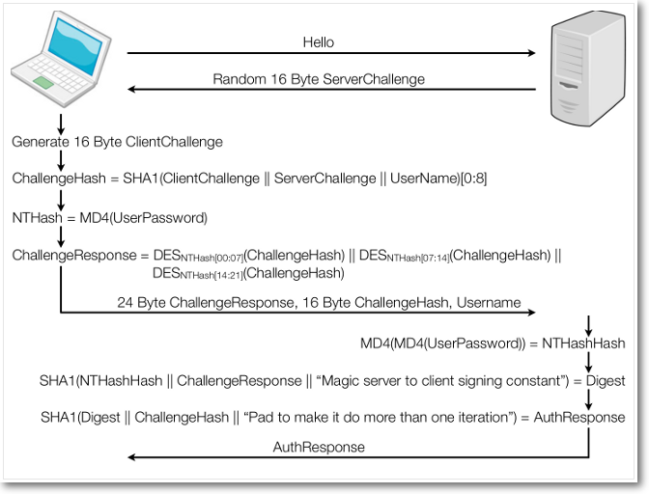

Slide 59
MS-CHAPv2 - II
If the decrypted blocks match the challenge, the Client is authenticated.
  The server computes a SHA-1 value obtained with Hash(H) and with constant literal “Magic server to client signing constant“
  The server generates an other hash value usign SHA with 20-byte output of the step 5, the challenge of 8-byte (step 3.b), and a costant “Pad to make it do more than one iteration“
  The 20 bytes are sent to client in the form “S=<hupper-case ASCII representation of the byte values>“
The Server uses the 16-byte Peer Authenticator Challenge from the client, as well as the Client's hashed password, to create a 20-byte Authenticator Response."
The Client also computes the Authenticator Response. If the computed response matches the received response, the Server is authenticated.

Slide 60
MPPE Key derivation
MPPE keys allow to decrypt MPPE/VPN traffic
MK = SHA1(NT password hash + RE + “This is the MPPE Master Key"). Truncate to get a 16-byte master-master key.
Derive two session keys:
  Hash the master-master key, 40 bytes of 0x00, an 84-byte constant and 40 bytes of 0xF2 with SHA. Truncate to get a 16-byte output.
  Constants: «Magic server to client constant», «Pad to make it do more than one iteration», «session key to client-to-server signing key magic constant»,

Slide 61
Weaknesses
Third DES key (K3) has a search space of 65535 combinations: K3 can be found quickly
Brute forcing speed up by checking only candidate passwords with last two bytes corresponding to K3
http://blog.rastating.com/cracking-pptp-ms-chapv2-with-chapcrack-cloudcracker/
https://www.cloudcracker.com/

Slide 62
Weaknesses
Generation of the 8-byte challenge
  It is not obvious nor documented as ..
  It is derived from information sent as clear text, so it can be calculated by an intruder
  Can be calculated from a potential intruder
  When the discovery challenge, the 'authenticator challenge, the peer challenge and the user's login is replaced by this information

Slide 63
AAA
Authentication, Authorization, Accounting - Part III

Slide 64
AAA: Authentication, Authorization, Accounting
Authentication:
Check user identity
Authorization:
Look up what she can do, authorize it
Accounting:
Record important actions; non repudiation; billing

Slide 65
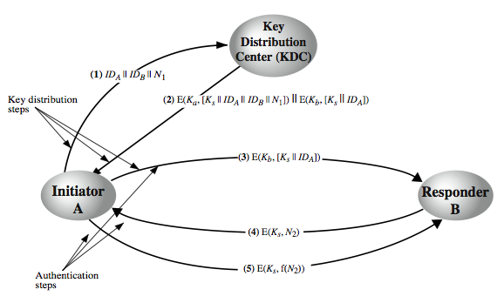
Key Distribution Scenario
Notes:
The key distribution concept can be deployed in a number of ways. A typical scenario is illustrated in Stallings Figure 14.3 above, which has a “Key Distribution Center” (KDC) which shares a unique key with each party (user). The text in section 14.1 details the steps needed, which are briefly:
1. A requests from the KDC a session key to protect a logical connection to B. The message includes the identity of A and B and a unique nonce N1.
2. The KDC responds with a message encrypted using Ka that includes a one-time session key Ks to be used for the session, the original request message to enable A to match response with appropriate request, and info for B
3. A stores the session key for use in the upcoming session and forwards to B the information from the KDC for B, namely, E(Kb, [Ks || IDA]). Because this information is encrypted with Kb, it is protected from eavesdropping.
At this point, a session key has been securely delivered to A and B, and they may begin their protected exchange. Two additional steps are desirable:
4. Using the new session key for encryption B sends a nonce N2 to A.
5. Also using Ks, A responds with f(N2), where f is a function that performs some transformation on N2 (eg. adding one). These steps assure B that the original message it received (step 3) was not a replay. Note that the actual key distribution involves only steps 1 through 3 but that steps 4 and 5, as well as 3, perform an authentication function.

Slide 66
IDP + SP + User
IDP: Identity provider
SP or RP: Service/Resource Provider

Slide 67
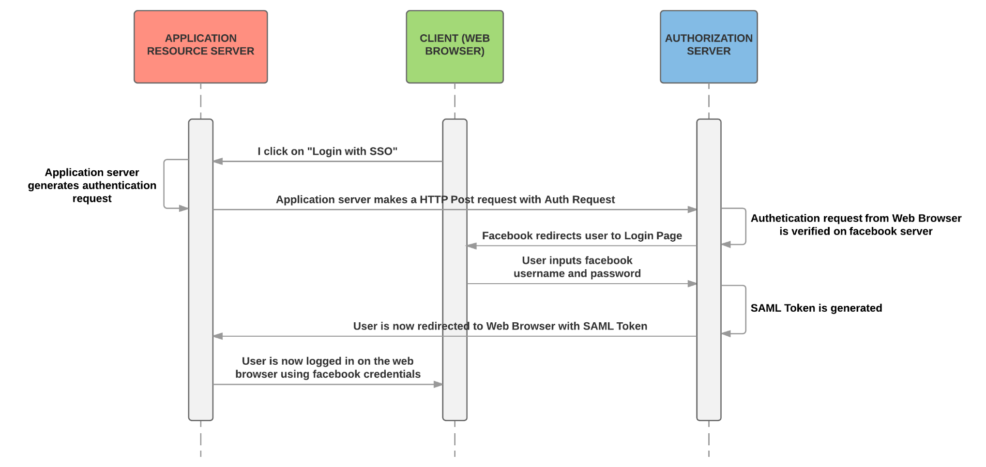
SAML Workflow

Slide 68
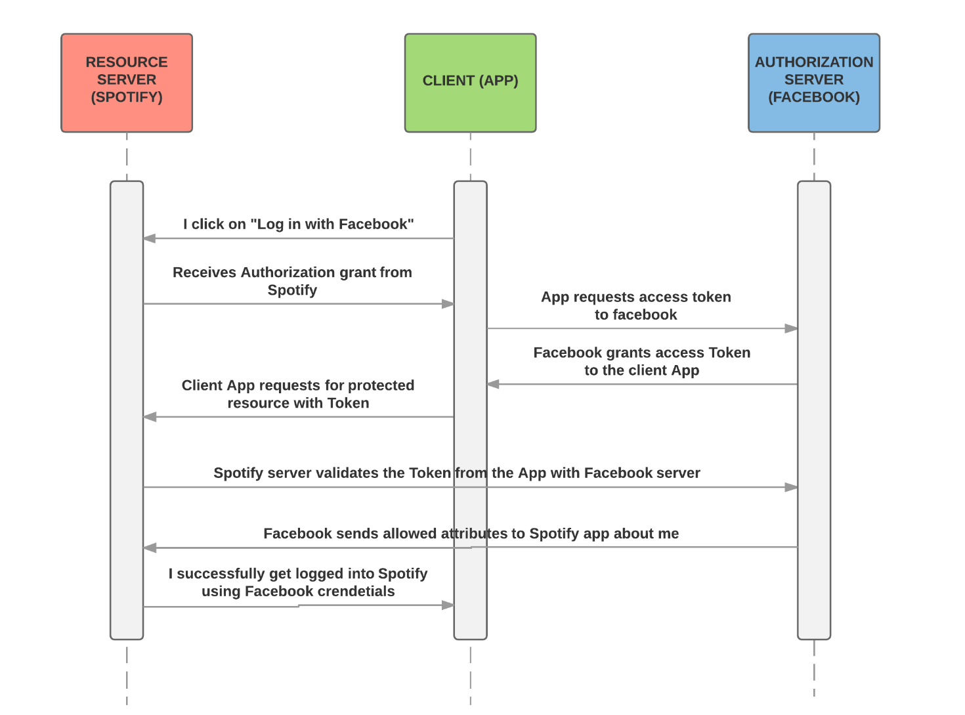
OAuth workflow

Slide 69
IDP + SP + Users II
A scheme typical of SAML, Oauth, Kerberos
  Benefits: SP’s do not handle credentials but authorization tokens
Oauth 2.0: Google, Facebook, OpenID
SAML: National SPID, IDEM network
Kerberos: common in the Microsoft ecosystem
IDPs become critical Unique Points of Failure

Slide 70
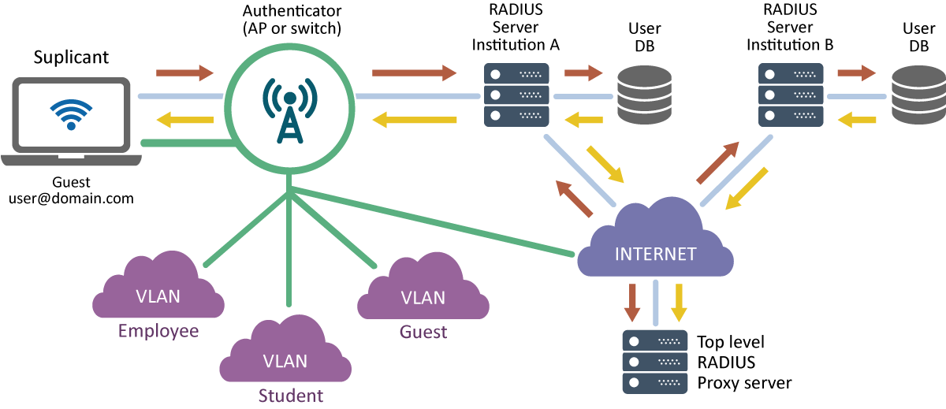
RADIUS Infrastructure

