Slide 1
Sistemi Operativi e Reti
Il livello fisico (PHY)

Slide 2
Il livello fisico
Aspetti importanti:
Modalità di trasmissione fisica dell’informazione
Materiali usati
Standardizzazione di apparati, cavi e connettori

Slide 3
Il Mezzo trasmissivo
Latenza
Banda
Rapporto segnale/rumore
Spazio e Tempo
Teorema del campionamento
Tasso di trasmissione max (Teorema di Nyquist): C = 2B log₂ H
Teorema di Shannon-Hartley: C = B log₂(1 + S/N)
Tecniche di trasmissione: binaria, fsk, qam
Suddivisione multicanale

Slide 4
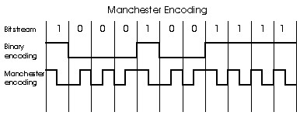
Manchester encoding
Used in 10BaseT
Each bit has a transition
Allows clocks in sending and receiving nodes to synchronize to each other
no need for a centralized, global clock among nodes!
Hey, this is physical-layer stuff!

Slide 5
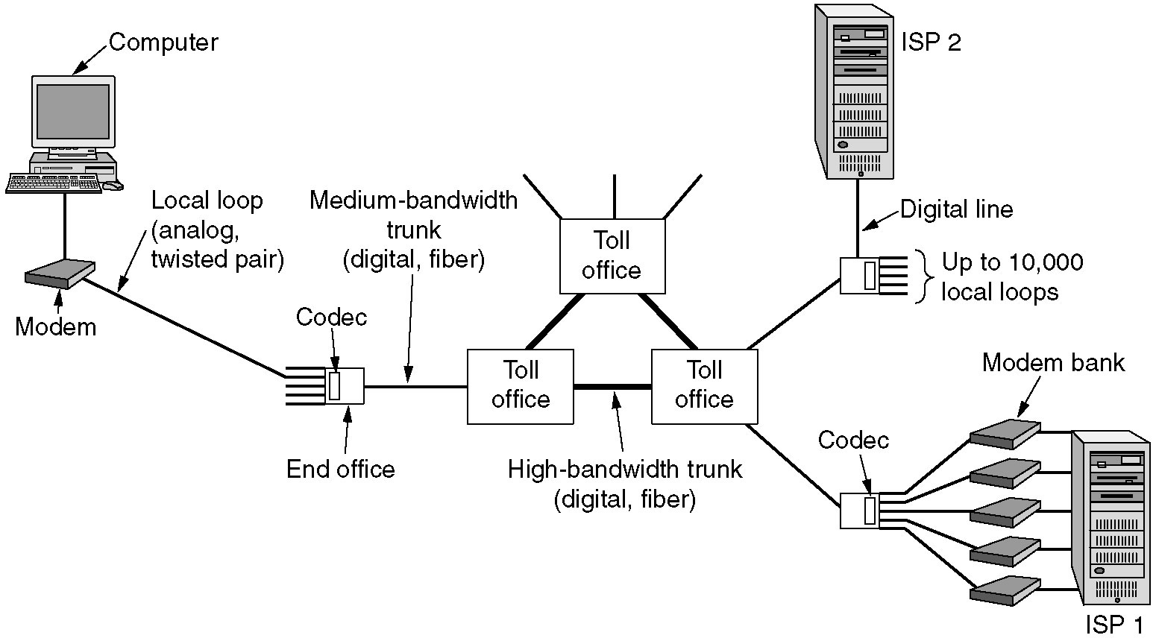
The Local Loop: Modems, ADSL, and Wireless
The use of both analog and digital transmissions for a computer to computer call. Conversion is done by the modems and codecs.

Slide 6
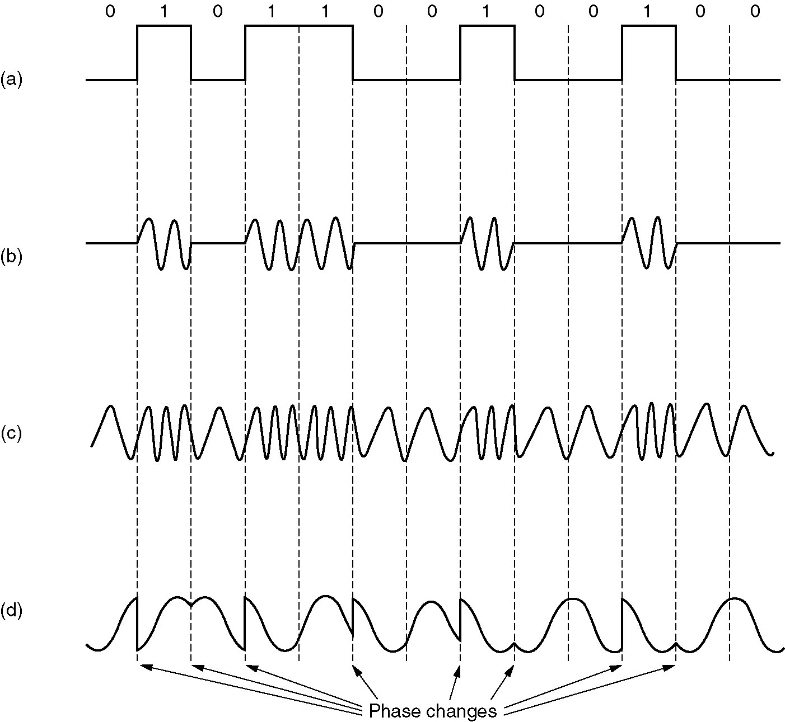
Modems
(a) A binary signal
(b) Amplitude modulation
(c) Frequency modulation
(d) Phase modulation

Slide 7
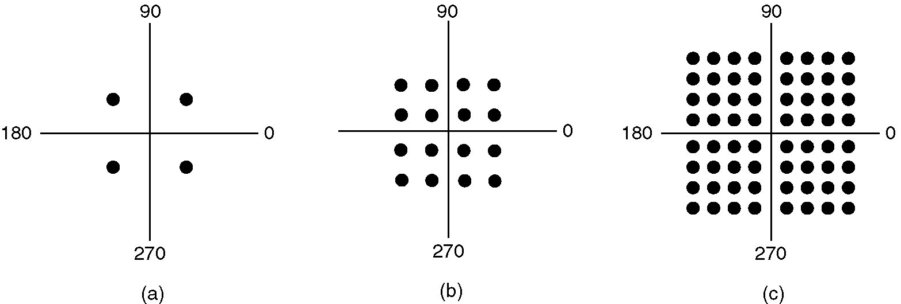
Modems (2)
(a) QPSK.
(b) QAM-16.
(c) QAM-64.

Slide 8
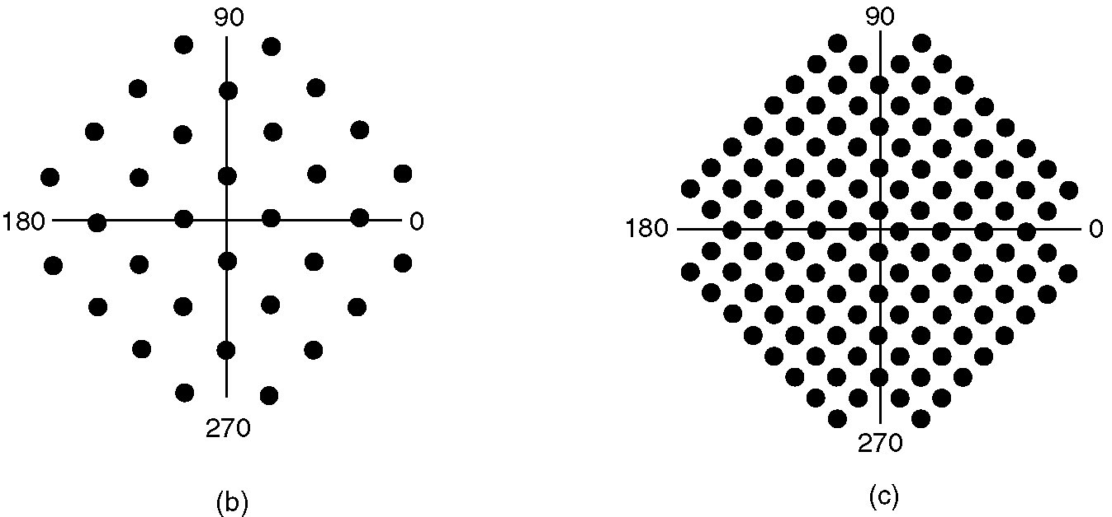
Modems (3)
(a)
(b)
(a) V.32 for 9600 bps.
(b) V32 bis for 14,400 bps.

Slide 9
Mezzi trasmissivi
Hanno anche essi uno spettro, detto spettro di attenuazione
Più lungo è la distanza percorsa dal segnale più è attenuato il segnale
Ma sono possibili anche distorsioni

Slide 10
Mezzi trasmissivi a guida
Doppino intrecciato
Cavo Coassiale
Fibra Ottica

Slide 11
Doppino Intrecciato
(a) Category 3 UTP.
(b) Category 5 UTP.

Slide 12
Cavo Coassiale

Slide 13
Fibra Ottica
La luce è intrappolata nella fibra

Slide 14
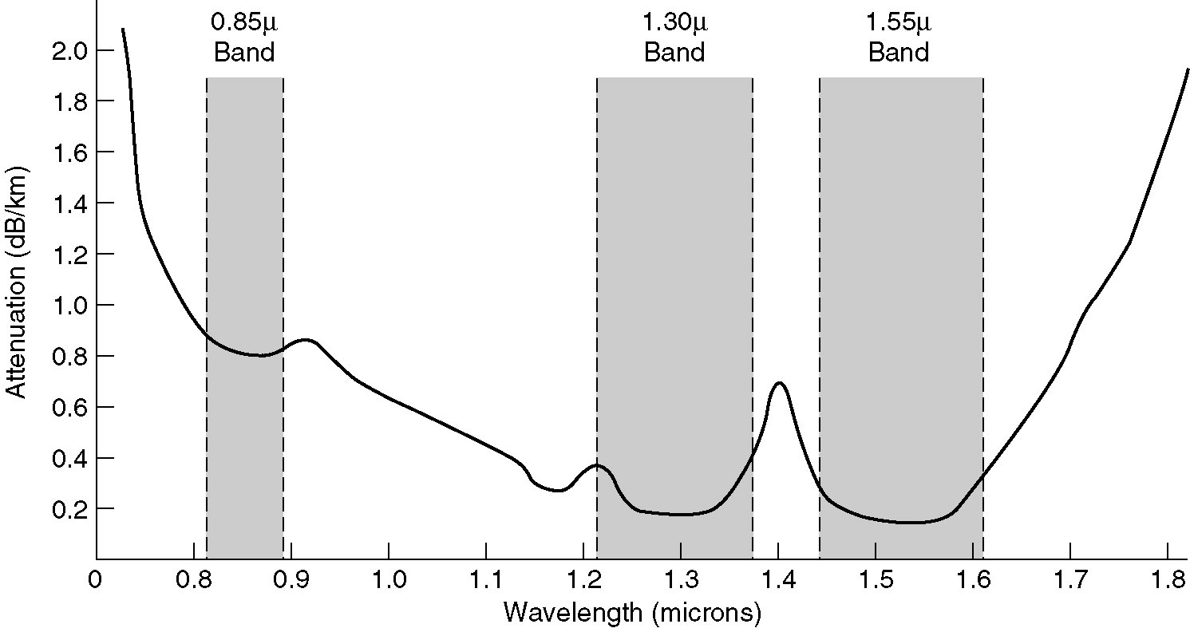
Trasmissione della luce
Attenuazione della fibra
Lunghezza d’onda = frequenza * velocità del segnale (300’000km/sec)
dB = 20 log₁₀ A

Slide 15
Fiber Cables
(a) Vista di una fibra singola
(b) Una guaina con tre fibre

Slide 16
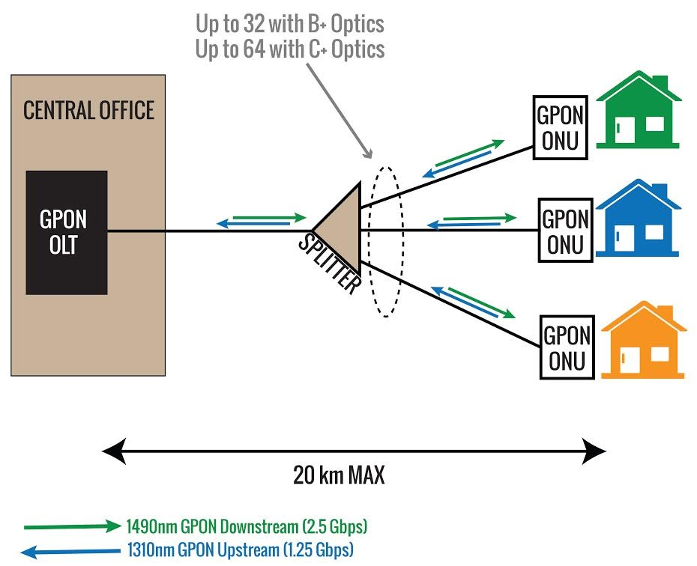
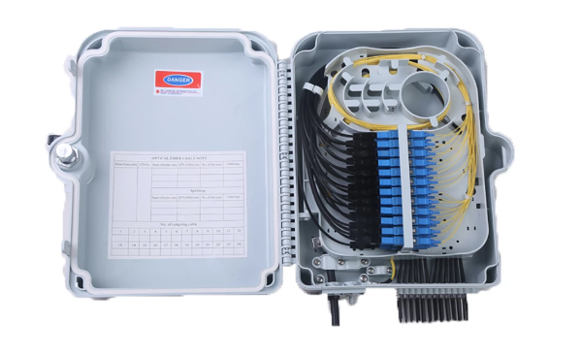
Tecnologie fibra ottica
Full duplex (802.3 esteso su fibra full duplex)
GPON

Slide 17
Le basi
Analisi di Fourier
Segnali a banda limitata
Massima velocità di un canale

Slide 18
Ogni segnale ha un suo ‘spettro’
Dipende dalle frequenze in gioco nel segnale
Es. Le voci acute hanno uno spettro spostato sulle frequenze alte, le voci basse hanno uno spettro spostato sulle voci basse
Questo vale anche per i segnali digitali
Maggiore è la banda in bit/sec, più ampio è lo spettro
Limite teorico dato dal teorema di Nyquist
DataRate = 2 S log₂ H
Ma più è alto H, più il rapporto segnale rumore è problematico!
Notes:
Qui fare disegni alla lavagna

Slide 19
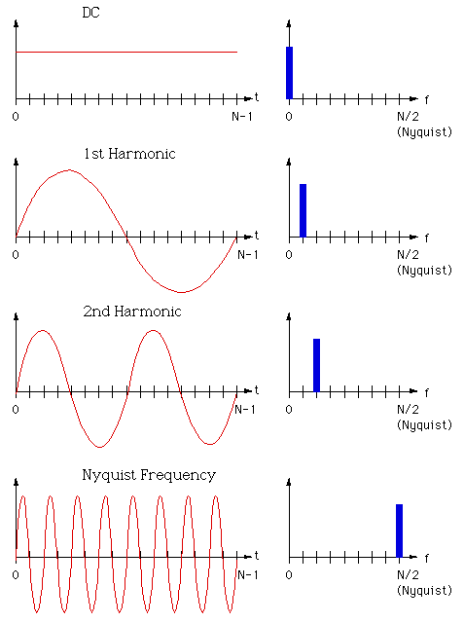
Segnali a banda (spettro) limitata

Slide 20
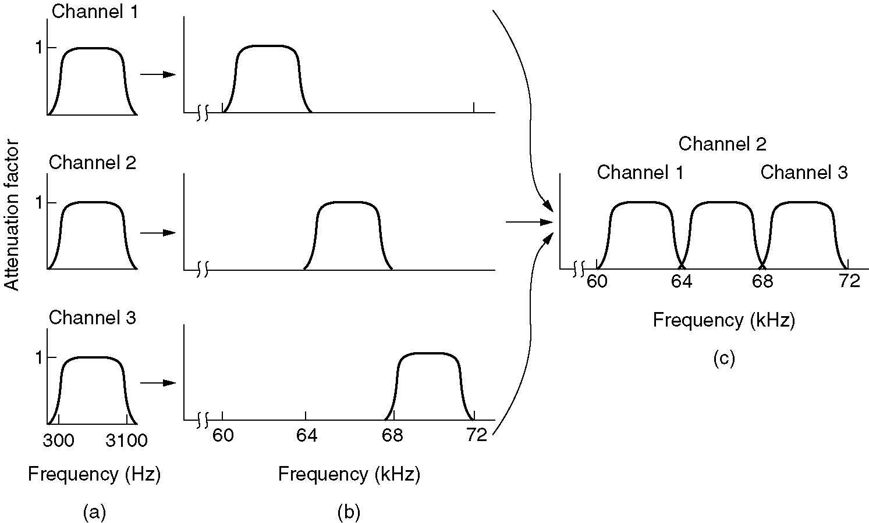
Frequency Division Multiplexing
(a) The original bandwidths.
(b) The bandwidths raised in frequency.
(b) The multiplexed channel.
- Segnali di spettro non sovrapposto possono coesistere!

Slide 21
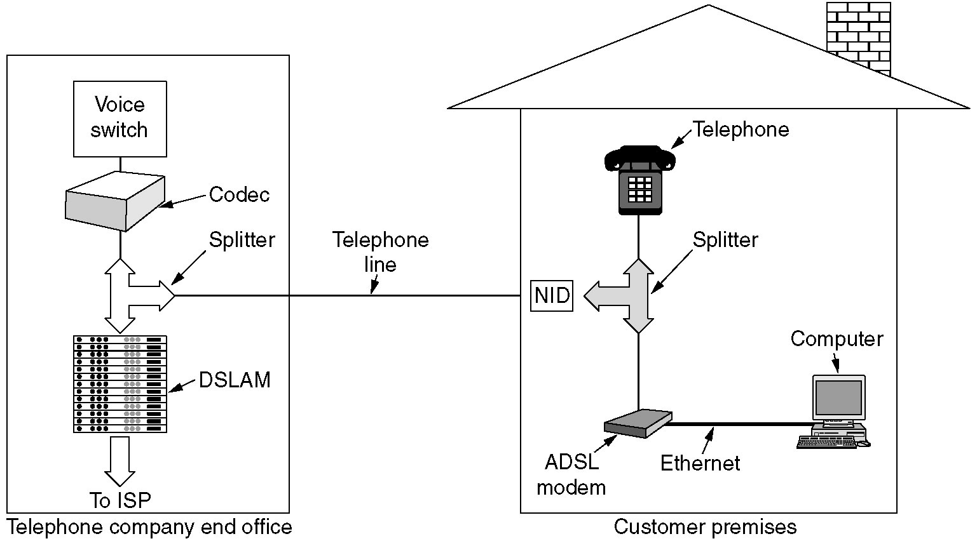
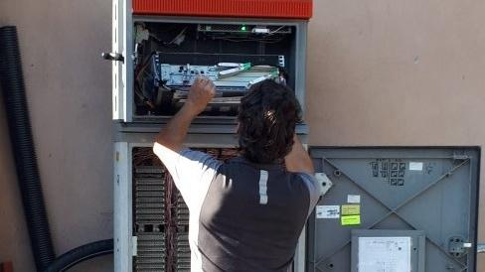
Digital Subscriber Lines (3)
A typical ADSL equipment configuration.

Slide 22
Digital Subscriber Lines (2)
Operation of ADSL/VDSL using discrete multitone modulation.
Usato per realizzazioni Fiber-to-the-street (FTTS/FTTC)

Slide 23
Attenuazione

Slide 24
Wifi Standards
https://en.wikipedia.org/wiki/IEEE_802.11ac-2013
https://en.wikipedia.org/wiki/IEEE_802.11ax-2021

Slide 25
Trasmissione non guidata
The Electromagnetic Spectrum
Radio Transmission
Microwave Transmission
Infrared and Millimeter Waves
Lightwave Transmission

Slide 26
802.11: Channels, association
802.11b: 2.4GHz-2.485GHz spectrum divided into 11 channels at different frequencies
AP admin chooses frequency for AP
interference possible: channel can be same as that chosen by neighboring AP!
host: must associate with an AP
scans channels, listening for beacon frames containing AP’s name (SSID) and MAC address
selects AP to associate with
may perform authentication [Chapter 8]
will typically run DHCP to get IP address in AP’s subnet

Slide 27
IEEE 802.11: multiple access
avoid collisions: 2⁺ nodes transmitting at same time
802.11: CSMA - sense before transmitting
don’t collide with ongoing transmission by other node
802.11: no collision detection!
difficult to receive (sense collisions) when transmitting due to weak received signals (fading)
can’t sense all collisions in any case: hidden terminal, fading
goal: avoid collisions: CSMA/C(ollision)A(voidance)
A
B
C
C
A’s signal
strength
C’s signal
strength
B
A
space

Slide 28
IEEE 802.11 MAC Protocol: CSMA/CA
802.11 sender
1 if sense channel idle for DIFS then
transmit entire frame (no CD)
2 if sense channel busy then
start random backoff time
timer counts down while channel idle
transmit when timer expires
if no ACK, increase random backoff interval, repeat 2
802.11 receiver
- if frame received OK
return ACK after SIFS (ACK needed due to hidden terminal problem)
sender
receiver
DIFS
data
SIFS
ACK

Slide 29
Avoiding collisions (more)
idea: allow sender to “reserve” channel rather than random access of data frames: avoid collisions of long data frames
sender first transmits small request-to-send (RTS) packets to BS using CSMA
RTSs may still collide with each other (but they’re short)
BS broadcasts clear-to-send CTS in response to RTS
RTS heard by all nodes
sender transmits data frame
other stations defer transmissions
Avoid data frame collisions completely
using small reservation packets!

Slide 30
Collision Avoidance: RTS-CTS exchange
A
B
AP
RTS(B)
RTS(A)
reservation collision
RTS(A)
CTS(A)
CTS(A)
DATA (A)
defer
time
ACK(A)
ACK(A)

Slide 31
802.11 frame: addressing
2
2
6
6
6
2
6
0 - 2312
4
frame
control
duration
address
1
address
2
address
3
seq
control
address
4
payload
CRC
Address 3: used only in ad hoc mode
Address 1: MAC address
of wireless host or AP
to receive this frame
Address 3: MAC address
of router interface to which AP is attached
Address 2: MAC address
of wireless host or AP
transmitting this frame

Slide 32
802.11 frame: addressing
Internet
H1
R1
router
AP
R1 MAC addr AP MAC addr
dest. address
source address
802.3 frame
AP MAC addr H1 MAC addr R1 MAC addr
address 1
address 2
address 3
802.11 frame

Slide 33
802.11 frame: more
frame seq #
(for reliable ARQ)
duration of reserved
transmission time (RTS/CTS)
2
2
6
6
6
2
6
0 - 2312
4
frame
control
duration
address
1
address
2
address
3
seq
control
address
4
payload
CRC
2
2
4
1
1
1
1
1
1
1
1
Protocol
version
Type
Subtype
To
AP
From
AP
More
frag
Retry
Power
mgt
More
data
WEP
Rsvd
frame type
(RTS, CTS, ACK, data)

Slide 34
Radio Transmission
(a) In the VLF, LF, and MF bands, radio waves follow the curvature of the earth.
(b) In the HF band, they bounce off the ionosphere.

Slide 35
Politics of the Electromagnetic Spectrum
The ISM bands in the United States.
http://www.eccsrl.it/html/campi.html
http://www.med.ira.inaf.it/Interferenze_page.htm

Slide 36
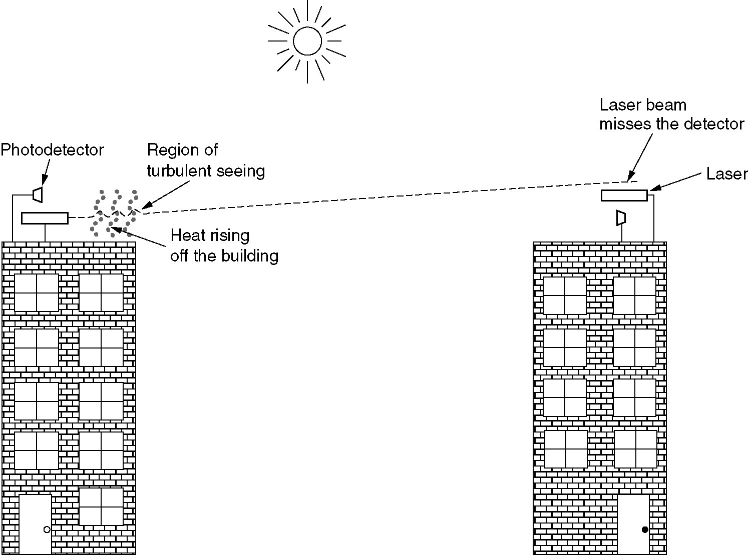
Lightwave Transmission

Slide 37
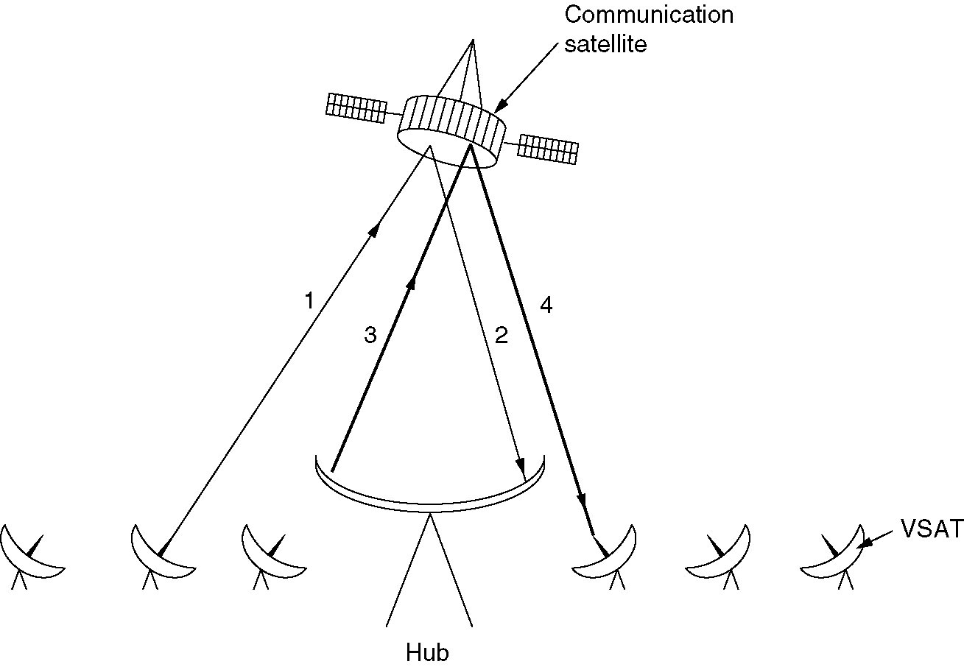
Communication Satellites (3)
VSATs using a hub.

Slide 38
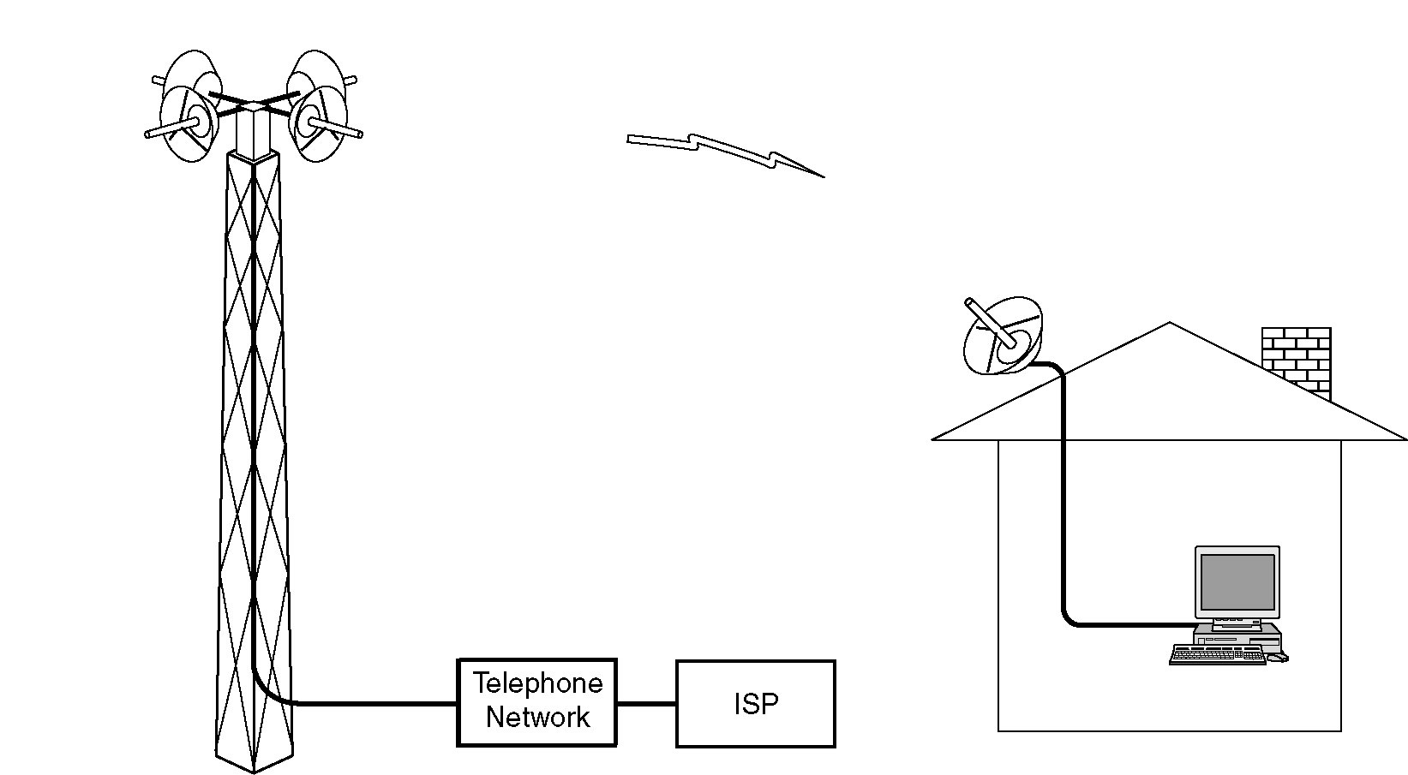
Wireless Local Loops
Architecture of an LMDS system.

Slide 39
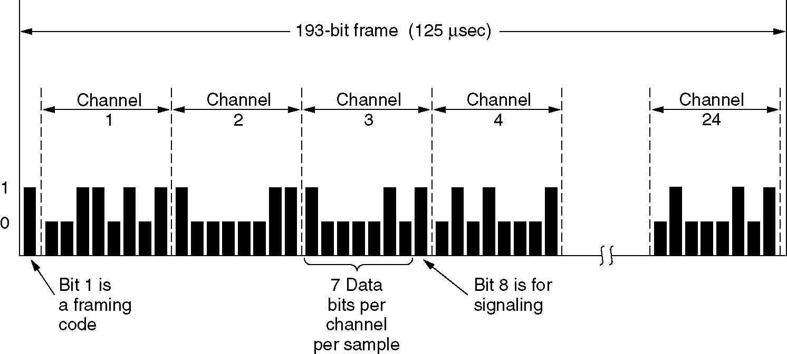
Time Division Multiplexing
The T1 carrier (1.544 Mbps).

Slide 40
Code Division Multiple Access (CDMA)
unique “code” assigned to each user; i.e., code set partitioning
all users share same frequency, but each user has own “chipping” sequence (i.e., code) to encode data
allows multiple users to “coexist” and transmit simultaneously with minimal interference (if codes are “orthogonal”)
encoding: inner product: (original data) X (chipping sequence)
decoding: summed inner-product: (encoded data) X (chipping sequence)

Slide 41
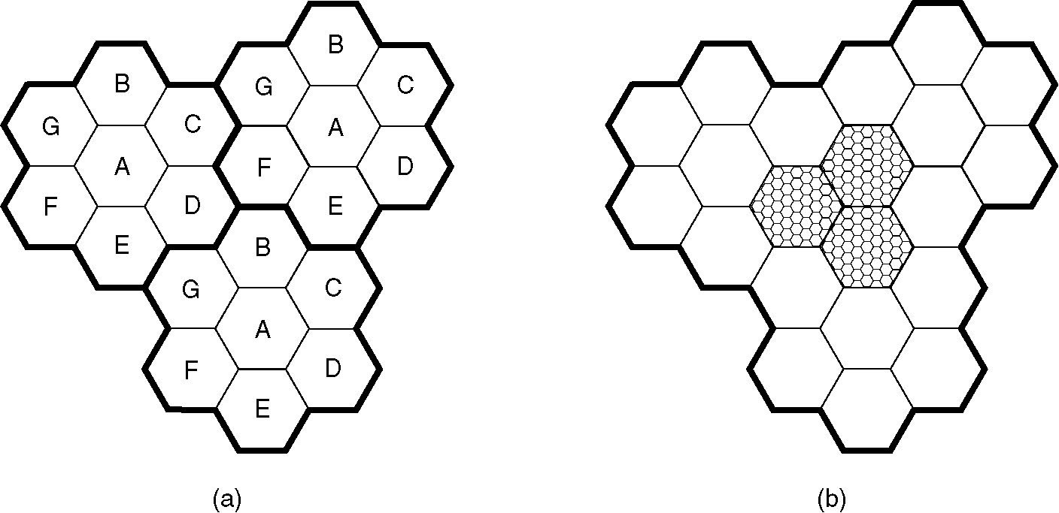
Advanced Mobile Phone System
(a) Frequencies are not reused in adjacent cells.
(b) To add more users, smaller cells can be used.

