Slide 1
Evaluation
Data Warehouse and Data Mining
Module II – Data Mining
Ph.D. Ettore Ritacco

Slide 2
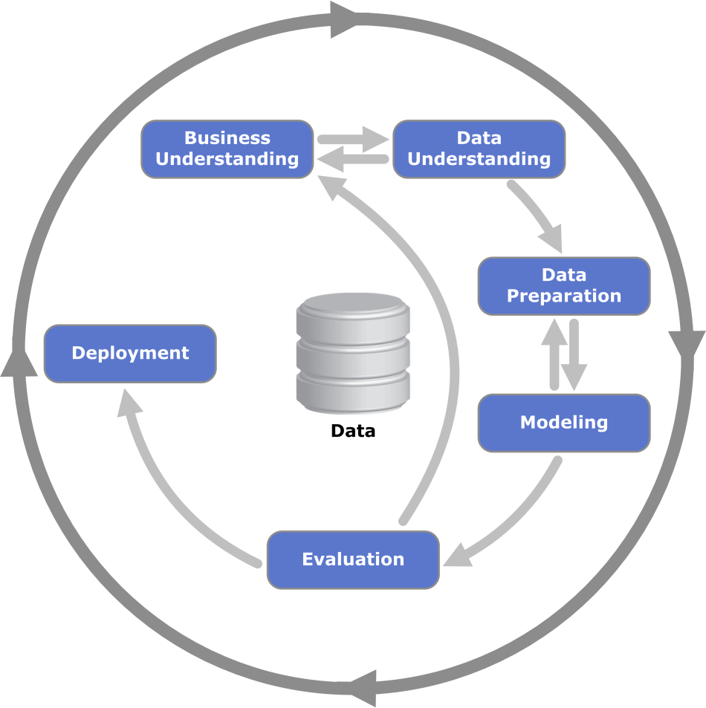
CRISP-DM Methodology

Slide 3
How to evaluate a model?
Select a training set
Build a mining model
Choose a quality measure
Select a test set
Apply the model on the test set
Compute the value of the quality measure

Slide 4
A simple evaluation schema
Data sources
Test set
Training set
Inference algorithm
Mining model
Evaluator

Slide 5
The fitting problem
Beyond the data analysis issues, there are challenges even in the modeling and evaluate phases in the CRISP-DM Methodology
Namely
Underfitting
The model is too simple: the evaluation will be poor on both the training and the evaluation set
Overfitting
The model is too complex, fitting as close as it can the training data, the evaluation will be good on the training set, but poor on the evaluation set

Slide 6
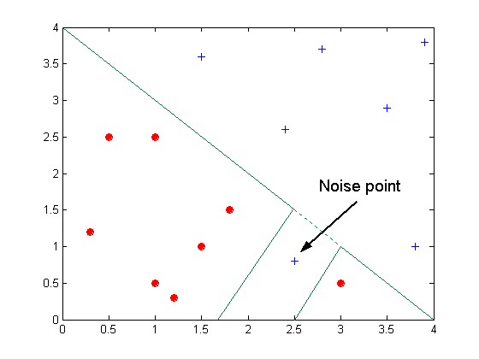
Overfitting (due to noise)

Slide 7
Overfitting (due to a too little dimension of the data set)

Slide 8
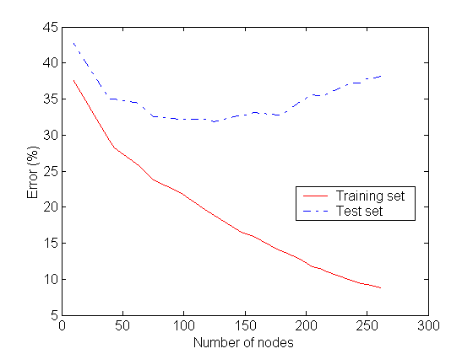
Overfitting

Slide 9
How to mitigate the overfittig?
Prevention
A good data preparation
Avoiding
Feed the building phase with further data for improving the model’s generality (e.g. online pruning)
Recovery
Manipulate the model after its creation (e.g. post pruning)

Slide 10
How to mitigate the overfittig?
Data sources
Test set
Validation set
Training set
Inference algorithm
Mining model
Evaluation

Slide 11
How to evaluate a model?
Is a model that achives 70% of global accuracy a “good” model?

Slide 12
How to evaluate a model?
Is a model that achives 70% of global accuracy a “good” model?
It dipends…

Slide 13
How to evaluate a model?
Is a model that achives 70% of global accuracy a “good” model?
It dipends…
Is a model that achives 95% of global accuracy a “good” model?

Slide 14
How to evaluate a model?
Is a model that achives 70% of global accuracy a “good” model?
It dipends…
Is a model that achives 95% of global accuracy a “good” model?
It dipends…

Slide 15
How to evaluate a model?
We can perform only comparative evaluations.
A “null hypothesis” (in other words, a baseline) is needed.
We can only say, given a statistic, if a model is better then another one, in terms of the chosen statistic.

Slide 16
True and estimated error
The “true” error of a hypothesis h in the domain D
The estimated (observed) error on a data set S
Where:

Slide 17
True Error
The probability of (exactly) r misclassifications in n evaluations is governed by a binomial distribution:

Slide 18
True Error – Binomial Distribution
Probability Mass Distribution
Cumulative Distribution Function
Expected Value
Variance & Standard Deviation

Slide 19
Estimated Error
Given a set of data S
Where e(x) are independent and identically distributed (i.i.d.) Bernoullian random variables:

Slide 20
Bernoulli Distribution
Probability Mass Distribution
Expected Value
Variance & Standard Deviation

Slide 21
Estimated Error Distribution
From the probability theory, the sum of i.i.d. Bernoulli variables is governed by a binomial distribution
Proof by induction: http://www.statlect.com/uddbin1.htm
e_{estimation}(h) is also a binomial distribution

Slide 22
Estimated Error Expected Value & Variance
Expected Value:
Variance:

Slide 23
Summary 1/2
There exists a link between the true error and the estimated error, if the data set S is representative of its domain
The strong law of large numbers

Slide 24
Summary 2/2
The estimated error is a binomial distribution, if |S| is great “enough”:

Slide 25
Binomial – Normal Approximation
If |S| is sufficient great (typically |S| > 30) the binomial distribution can be approximated by a normal distribution
Central limit theorem
“states that the distribution of the sum (or average) of a large number of independent, identically distributed variables will be approximately normal, regardless of the underlying distribution.”

Slide 26
Normal Distribution
Normal distribution

Slide 27
Normal Distribution
Normal distribution
Density
Cumulative
Expected Value
Variance

Slide 28
Mean and Variance Approximation
Due to the binomial – normal approximation

Slide 29
Why are we interested in the Normal distribution?
Confidence Intervals
Given a probability α, we are interested in finding an interval [a, b] such that
In the normal case
 | 50% | 68% | 80% | 90% | 95% | 98% | 99%
z_{N} | 0.67 | 1.00 | 1.28 | 1.64 | 1.96 | 2.33 | 2.58

Slide 30
Why are we interested in the Normal distribution?
This means that the true error is in the interval
With probability
 | 50% | 68% | 80% | 90% | 95% | 98% | 99%
z_{N} | 0.67 | 1.00 | 1.28 | 1.64 | 1.96 | 2.33 | 2.58

Slide 31
How to compare models?
Consider two hypothesis h and j…
… and the random variable
It’s governed by a binomial distribution
Choose z_{n} and consequently

Slide 32
How to compare models?
Three cases:
Zero is in the confidence interval of d
There is no statistical difference between h and j, with significance
The confidence interval of d is under Zero
e(h) is statistically lower than e(j), with significance
The confidence interval of d is above Zero
e(h) is statistically higher than e(j), with significance

Slide 33
How to compare models?
Where:
And, since the hypothesis are independent:

Slide 34
Evaluation Example
Let
e(h) = 0.15, with |S₁| = 30
e(j) = 0.25, with |S₂| = 5000
Then:
d = |e(h) – e(j)|

Slide 35
Evaluation Example
The expected value:
The standard deviation:

Slide 36
Evaluation Example
With probability 0.95, the confidence interval is:
The confidence interval contains 0:
The difference is not statistically significant

Slide 37
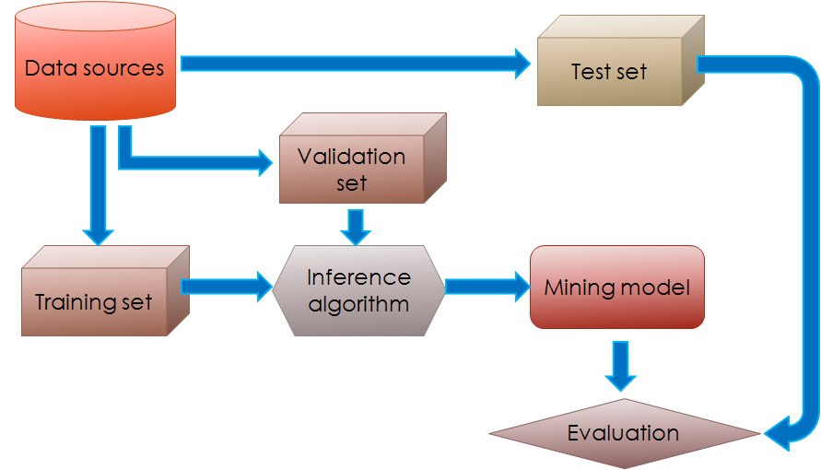
Methods for model evaluation
Hold-out

Slide 38
Methods for model evaluation
Hold-out
Pros:
Fast evaluation
Cons:
Only one experiment ➔ low statistical relevance

Slide 39
Methods for model evaluation
Repeated Hold-out with random sub-sampling
Choose n
ResultList = { }
For 1 < i < n
Random Sampling of (with or without replacement):
Training set
Validation set
Test set
Model = buildModel(Training set, Validation set)
ResultList.add(evaluateModel(Model, Test set))
Return avg(ResultList )

Slide 40
Methods for model evaluation
Repeated Hold-out with random sub-sampling
Pros:
More statistical significance
Cons:
Slow evaluation
Not all the tuples are involved in the training and evaluation phase

Slide 41
Methods for model evaluation
k-fold Cross Validation
Choose k
Divide the whole dataset D in k folds (portion)
ResultList = { }
For 1 < i < k
Build Training set = D \ fold_{i}
Random sample the Validation Set from the Training Set
Training set = Training set \ Validation Set
Test set = fold_{i}
Model = buildModel(Training set, Validation set)
ResultList.add(evaluateModel(Model, Test set))
Return avg(ResultList )

Slide 42
Methods for model evaluation
k-fold Cross Validation
Pros:
Good statistical significance
the greater is k the better the significance
If k = |D| Cross Validation is called leave-one-out evaluation
Cons:
Very slow evaluation
The k-fold Cross Validation needs to be stratified:
Each fold has to keep the same statistical properties of the whole dataset

Slide 43
Evaluation Metrics
The focus is on the predictive quality of a model
instead of computational cost, scalability…
Confusion Matrix
 | Predicted class
Actual class |  | Class = Yes | Class = No
 | Class = Yes | True Positive (TP) | False Negative (FN)
 | Class = No | False Positive (FP) | True Negative (TN)

Slide 44
Global Accuracy
Global Accuracy
The number of all the well-predicted observation over the cardinality of the data set

Slide 45
Global Accuracy Limits
Is a global accuracy of 99.9% good?
Example:
Binary Classification
#records of class 0 = 9990
# records of class 1 = 10
A classifier that predicts always 0:
Global Accuracy = 99.9%
But the model is useless!

Slide 46
Cost Matrix
Similar to the confusion matrix
C(i|j) is the cost of predicting a record as class i when the actual class is j
 | Predicted class
Actual class | C(i|j) | Class = Yes | Class = No
 | Class = Yes | C(Yes|Yes) | C(No|Yes)
 | Class = No | C(Yes|No) | C(No|No)

Slide 47
Cost Evaluation of 2 Models (M1, M2)
Cost Matrix | Predicted class
Actual class | C(i|j) | Yes | No
 | Yes | -1 | 100
 | No | 1 | 0
Accuracy: 0.8 Accuracy: 0.9
Cost: 3910 Cost: 4255
Confusion Matrix M1 | Predicted class
Actual Class | C(i|j) | Yes | No
 | Yes | 150 | 40
 | No | 60 | 250
Confusion Matrix M2 | Predicted class
Actual Class | C(i|j) | Yes | No
 | Yes | 250 | 45
 | No | 5 | 200

Slide 48
Cost-sensitive Measures
For each class
Precision: the confidence of model
How much can I trust a prediction?
Recall: the coverage of a model
How many records of a specific class can my model correctly predict?
F1-Measure: harmonic mean of precision and recall

Slide 49
The Previous Example
Binary Classification
#records of class 0 = 9990
# records of class 1 = 10
A classifier that predicts always 0:
Global Accuracy = 0.999
Precision of class 1: NaN (0 / 0)
Recall of class 1: 0
Precision of class 0: 0.999
Recall of class 0: 1

Slide 50
ROC (Receiver Operating Characteristic)
The ROC curve is a graphical plot that illustrates the performance of a binary classifier system as its discrimination threshold is varied

Slide 51
Threshold
Given a binary classifier the following rule holds:
Standard threshold

Slide 52
Threshold
What happens if we vary the threshold value?

Slide 53
Threshold
What happens if we vary the threshold value?
For each threshold we have a different classification rule

Slide 54
Threshold
What happens if we vary the threshold value?
For each threshold we have a different classification rule
For each rule we have a prediction

Slide 55
Threshold
What happens if we vary the threshold value?
For each threshold we have a different classification rule
For each rule we have a prediction
For each prediction we have a confusion matrix

Slide 56
Threshold
What happens if we vary the threshold value?
For each threshold we have a different classification rule
For each rule we have a prediction
For each prediction we have a confusion matrix
For each confusion matrix we have a FPR and a TPR

Slide 57
Threshold
What happens if we vary the threshold value?
For each threshold we have a different classification rule
For each rule we have a prediction
For each prediction we have a confusion matrix
For each confusion matrix we have a FPR and a TPR
For each FPR and TPR we have a point in the ROC space

Slide 58
Threshold
What happens if we vary the threshold value?
For each threshold we have a different classification rule
For each rule we have a prediction
For each prediction we have a confusion matrix
For each confusion matrix we have a FPR and a TPR
For each FPR and TPR we have a point in the ROC space
Examples:

Slide 59
How to build a ROC curve
Instance | P(+|x) | True Class
1 | 0.95 | +
2 | 0.93 | +
3 | 0.87 | -
4 | 0.85 | -
5 | 0.85 | -
6 | 0.85 | +
7 | 0.76 | -
8 | 0.53 | +
9 | 0.43 | -
10 | 0.25 | +
Sort the records according to P(+|x) [Descendent]
Each P(+|x) will be a threshold
For each threshold, compute the confusion matrix
Compute FPR and TPR

Slide 60
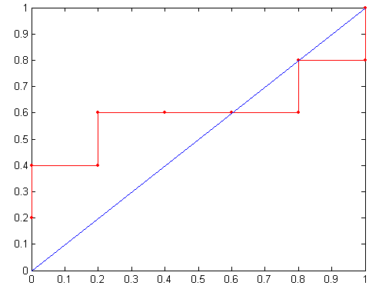
Threshold >=
ROC curve:

Slide 61
How to evaluate a ROC curve

Slide 62
How to evaluate a ROC curve
High-precision zone

Slide 63
How to evaluate a ROC curve
High-recall zone
High-precision zone

Slide 64
How to evaluate a ROC curve
Best Point
High-recall zone
High-precision zone

Slide 65
How to evaluate a ROC curve

Slide 66
ROC comparison
The greater the area under the curve the better the quality of the model
Which is better?

Slide 67
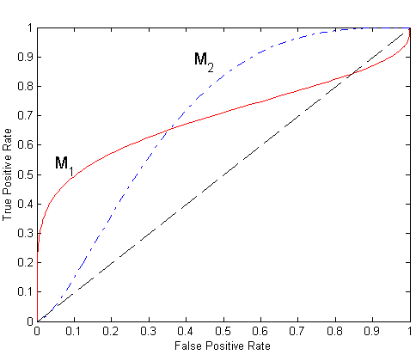
ROC comparison
Which is better?

Slide 68
ROC comparison
Which is better?
If we are interested in precision?

Slide 69
ROC comparison
Which is better?
If we are interested in precision?
If we are interested in recall?

Slide 70
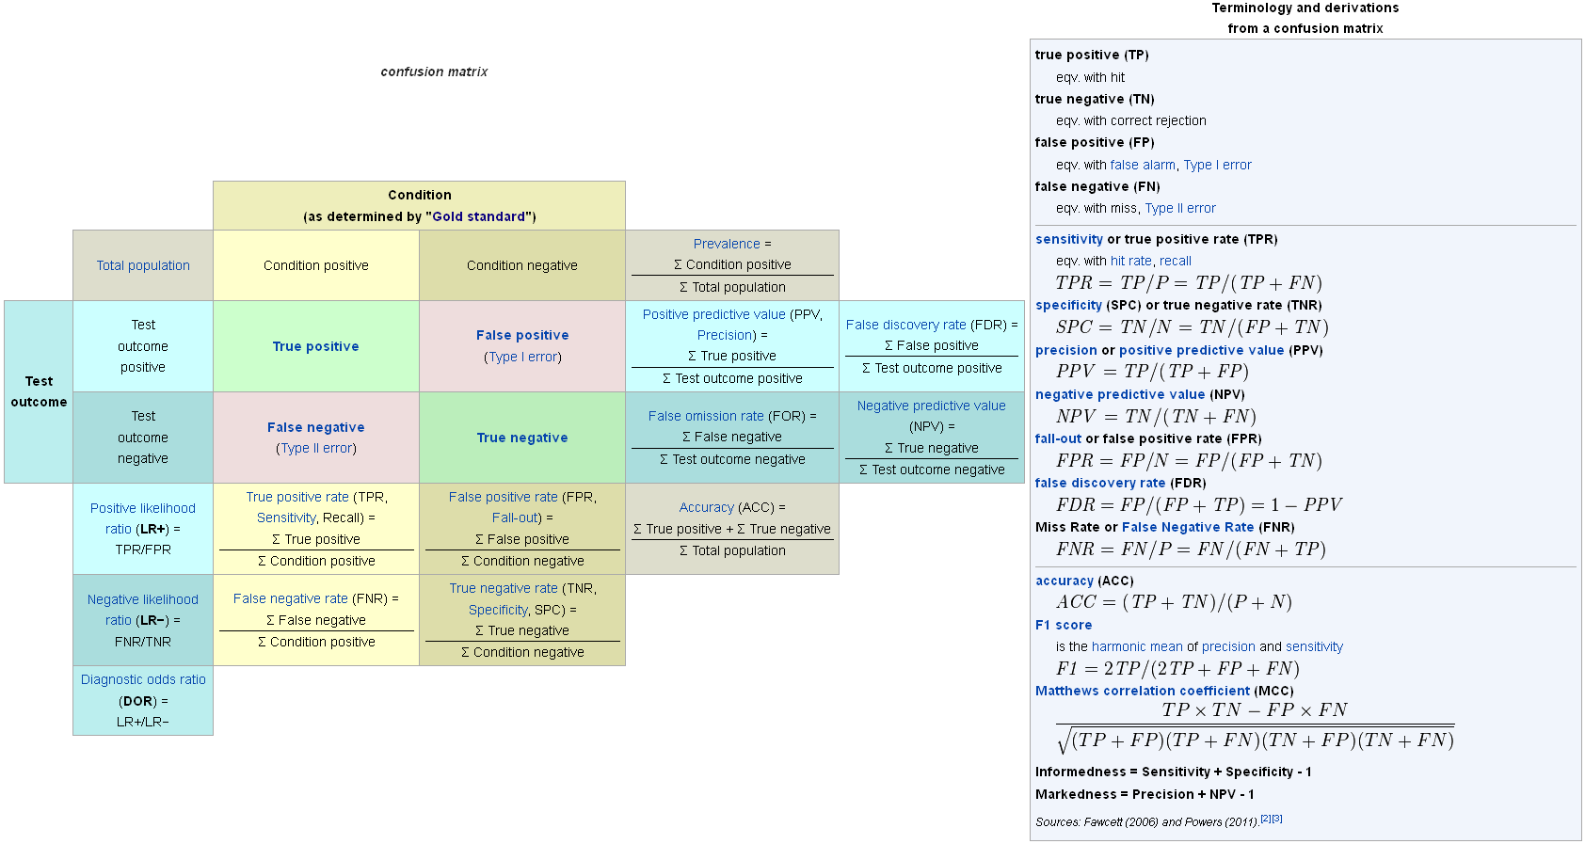
Confusion Matrix Glossary

