Slide 1
Exercises – NB & DT
Data Warehouse and Data Mining
Module II – Data Mining
Ph.D. Ettore Ritacco

Slide 2
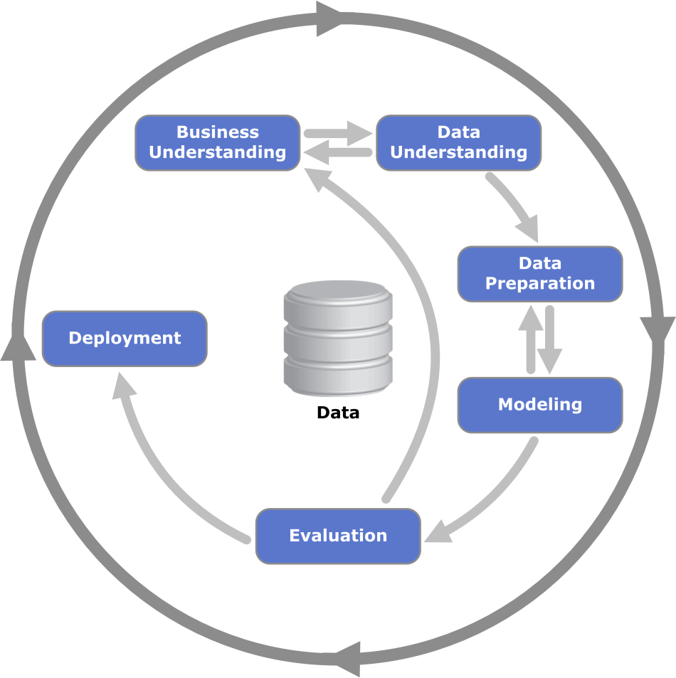
CRISP-DM Methodology

Slide 3
Data set
x | y | z | U
0 | 0 | 1 | 0
1 | 1 | 1 | 0
1 | 0 | 0 | 1
0 | 1 | 1 | 0
0 | 0 | 1 | 0
0 | 1 | 0 | 1
1 | 0 | 1 | 1
1 | 1 | 0 | 1
1 | 1 | 1 | 0
1 | 0 | 1 | 1

Slide 4
Exercise 1
Assume all attributes are nominal
Assume U is the class attribute
Build a decision tree based on the information gain measure

Slide 5
Solution
Note:
Then…

Slide 6
Solution
H(D): [5+,5-] ===> H(D) = 1
H(x = 0): [1+,3-] ===>
H(x = 0) = -1/4*log2(1/4)-3/4*log2(3/4) = 0.8113
H(x = 1): [4+,2-] ===>
H(x = 1) = -4/6*log2(4/6)-2/6*log2(2/6) = 0.9183
Gain (D, x) = H(D) – (4/10)*H(x = 0)-(6/10)*H(x = 1)
= 1-(4/10)*0.8113-(6/10)*0.9183 = 0.124
Similarly:
Gain (D, y) = 0.029 e Gain (D, z) = 0.514.
The splitting attribute is z.

Slide 7
Solution
Iterating, we obtain:
z
0
1
1
x
0
1
0
y
0
1
1
0

Slide 8
Exercise 2
Assume all attributes are nominal
Assume U is the class attribute
Build a Naïve Bayes Classifier
Classify the tuple [x=1, y=0, z=1]

Slide 9
Solution
x |  |  | y |  |  | z |  |  | U
U = | 1 | 0 | U = | 1 | 0 | U = | 1 | 0 | U = | 1 | 0
1 | 4 | 2 | 1 | 2 | 3 | 1 | 2 | 5 |  | 5 | 5
0 | 1 | 3 | 0 | 3 | 2 | 0 | 3 | 0
U = | 1 | 0 | U = | 1 | 0 | U = | 1 | 0 | U = | 1 | 0
1 | 4/5 | 2/5 | 1 | 2/5 | 3/5 | 1 | 2/5 | 5/5 | 1 | 5/10 | 5/10
0 | 1/5 | 3/5 | 0 | 3/5 | 2/5 | 0 | 3/5 | 0/5 | 0

Slide 10
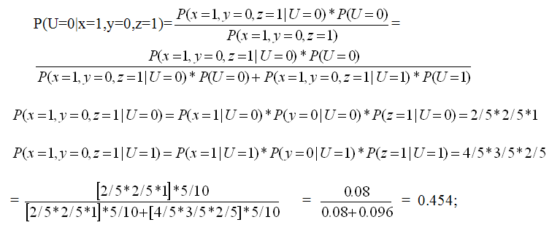
Solution
The prediction is U = 1

