Slide 1
Exercises – RL & IBC
Data Warehouse and Data Mining
Module II – Data Mining
Ph.D. Ettore Ritacco

Slide 2
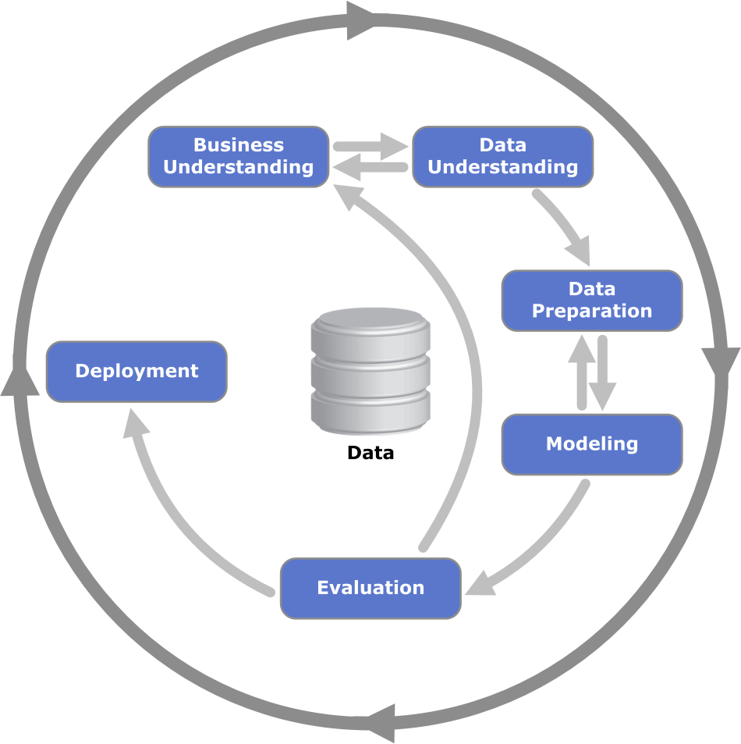
CRISP-DM Methodology

Slide 3
Data set
id | x | y | z | U
1 | 0 | 0 | 1 | 0
2 | 1 | 1 | 1 | 0
3 | 1 | 0 | 0 | 1
4 | 0 | 1 | 1 | 1
5 | 0 | 0 | 1 | 0
6 | 0 | 1 | 0 | 1
7 | 1 | 0 | 1 | 0
8 | 1 | 1 | 0 | 1
9 | 1 | 1 | 1 | 0
10 | 1 | 0 | 1 | 0

Slide 4
Exercise 1
Assume all attributes are numeric
Ignore “id”
Assume U is the class attribute
Classify instance [x = 2, y = 1, z = 2] with a KNN classifier with:
Euclidean distance
K = 3

Slide 5
Solution
Note:
Then…

Slide 6
Solution
Closest tuples are {3, 5, 6} whose classes are (resp.) {1, 0 ,1} ==> 3NN – Prediction: U = 1
id | Euclidean distance
1 | 2,4494897
2 | 1,7320508
3 | 1
4 | 1,4142136
5 | 1
6 | 1
7 | 1,4142136
8 | 1,4142136
9 | 1,7320508
10 | 1,4142136

Slide 7
Exercise 2
Assume all attributes are nominal
Assume U is the class attribute
Build a Sequential Covering Classifier with accuracy >= 0.8
Classify the tuple [x=1, y=0, z=1]

Slide 8
Solution
Note:
Then…

Slide 9
Solution
Ruleset = {}
Dataset = {1, 2, 3, 4, 5, 6, 7, 8, 9, 10}
Choose the rare class: U = 1
Build first rule
R1 = {}
X = 1: cov = 6, sat = 2, accuracy = 0.333
X = 0: cov = 4, sat = 2, accuracy = 0.5
Y = 1: cov = 5, sat = 3, accuracy = 0.6
Y = 0: cov = 5, sat = 1, accuracy = 0.2
Z = 1: cov = 7, sat = 1, accuracy = 0.143
Z = 0: cov = 3, sat = 3, accuracy = 1
The rule Z = 0 ➔ U = 1 has accuracy 1.0 >= 0.8

Slide 10
Solution
Update Ruleset = { R1:[Z = 0 ➔ U = 1, acc = 1] }
Update Dataset = {1, 2, 4, 5, 7, 9, 10}
X = 1: cov = 4, sat = 0, accuracy = 0
X = 0: cov = 3, sat = 1, accuracy = 0.333
Y = 1: cov = 3, sat = 1, accuracy = 0.333
Y = 0: cov = 4, sat = 0, accuracy = 0
Z = 1: cov = 3, sat = 1, accuracy = 0.333
Z = 0: cov = 0, sat = 0, accuracy = NaN
No rule has accuracy >= 0.8
The best rules are X = 0 and Y = 1

Slide 11
Solution
Starting from X = 0
X = 0 AND Y = 1: cov = 1, sat = 1, accuracy = 1
X = 0 AND Y = 0: cov = 2, sat = 0, accuracy = 0
X = 0 AND Z = 1: cov = 2, sat = 0, accuracy = 0
X = 0 AND Z = 0: cov = 0, sat = 0, accuracy = NaN
The rule X = 0 AND Y = 1 ➔ U = 1 has accuracy 1.0 >= 0.8
Y = 1 has been just used
There are no more tuples with U = 1
The algorithm stops

Slide 12
Solution
The classifier is:
R1: [Z = 0 ➔ U = 1, acc = 1]
R2: [X = 0 AND Y = 1 ➔ U = 1, acc = 1]
Default: [ ➔ U = 0, acc = 6/7 = 0.857]
The tuple [X=1, Y=0, Z=1] is classified as U = 0
Note: rules must be applied according to the order of the classifier’s ruleset.

